Slide 1
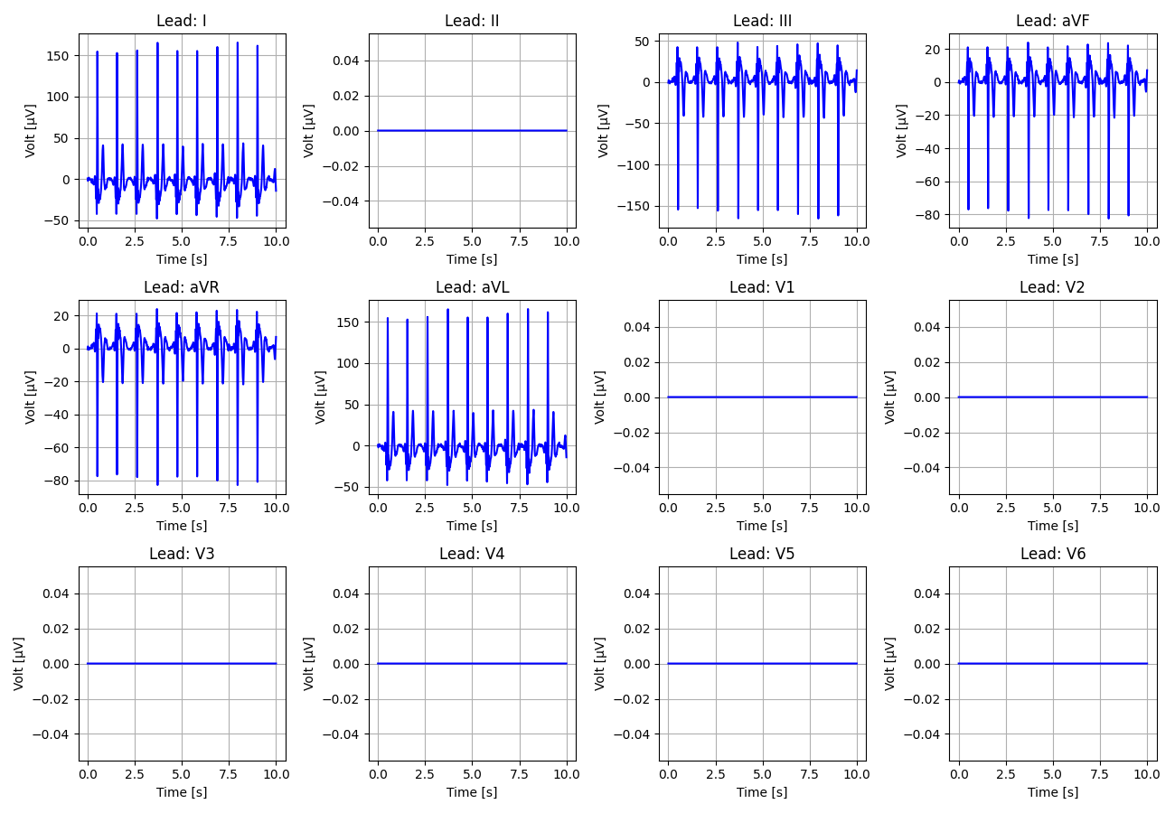
1_Recording_1815022

Slide 2
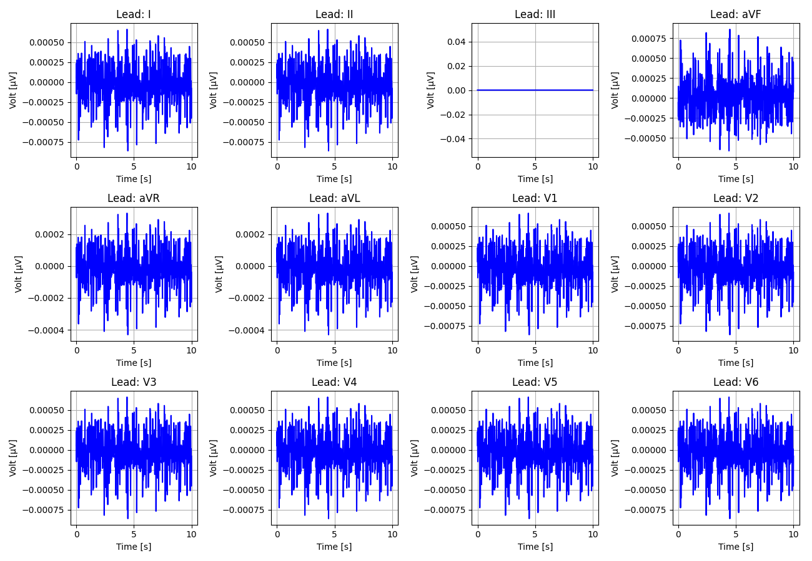
2_Recording_2607229

Slide 3
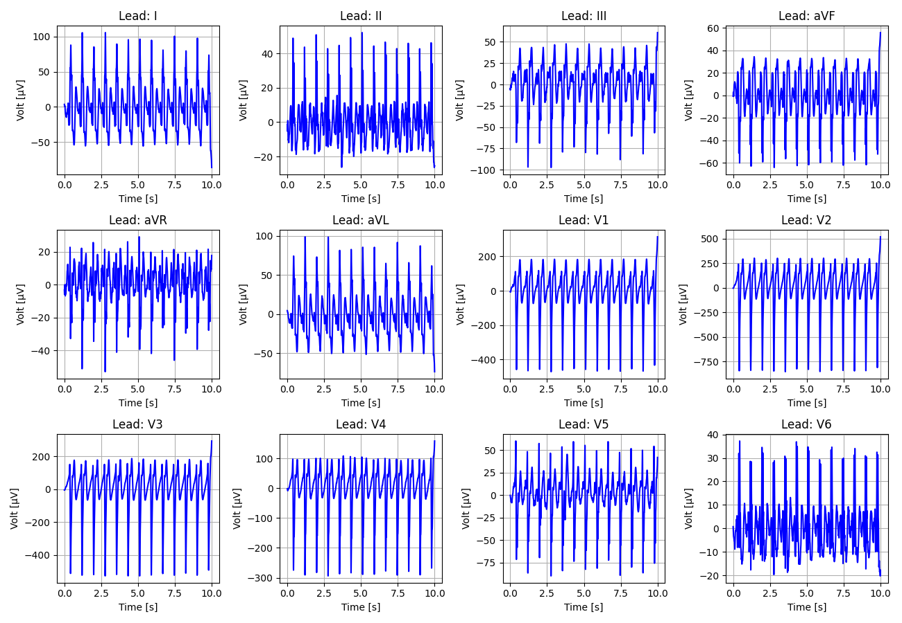
3_Recording_2674090

Slide 4
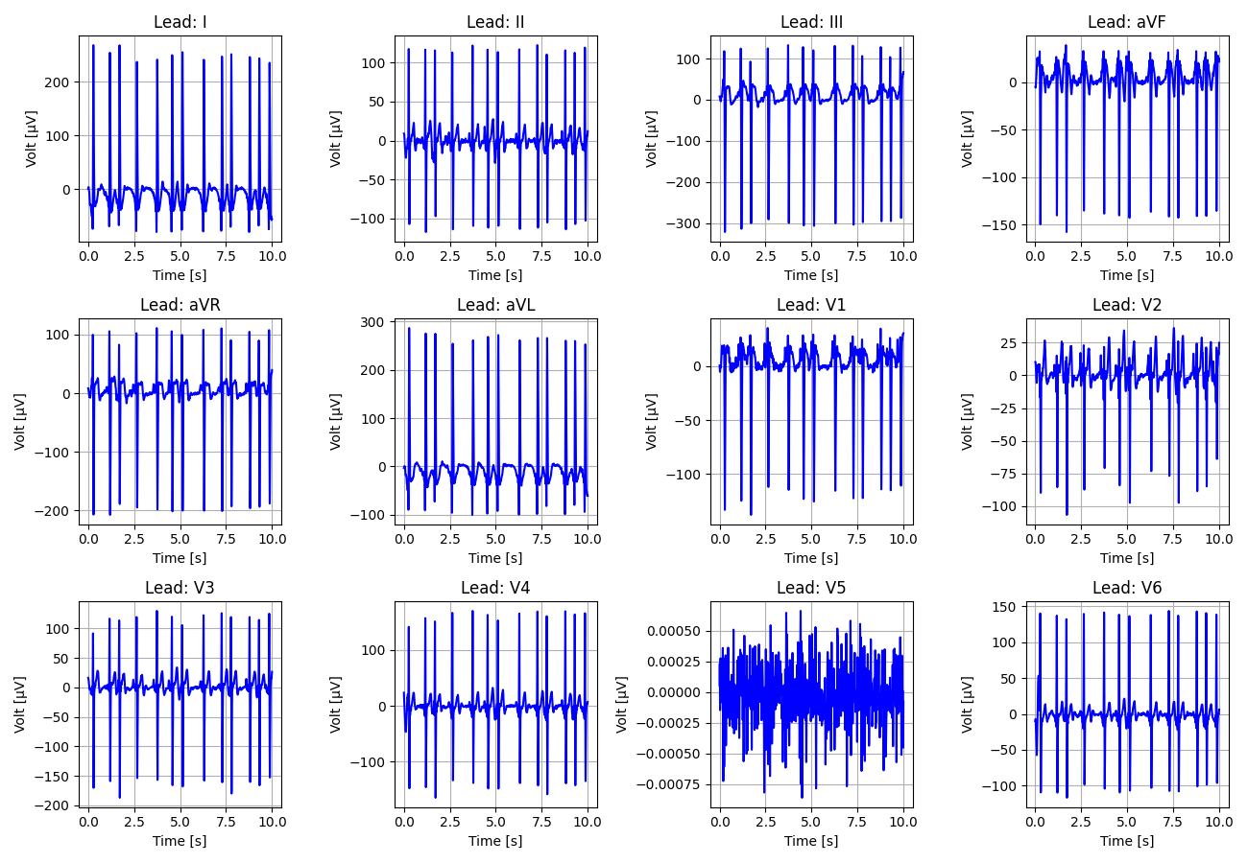
4_Recording_2813744

Slide 5
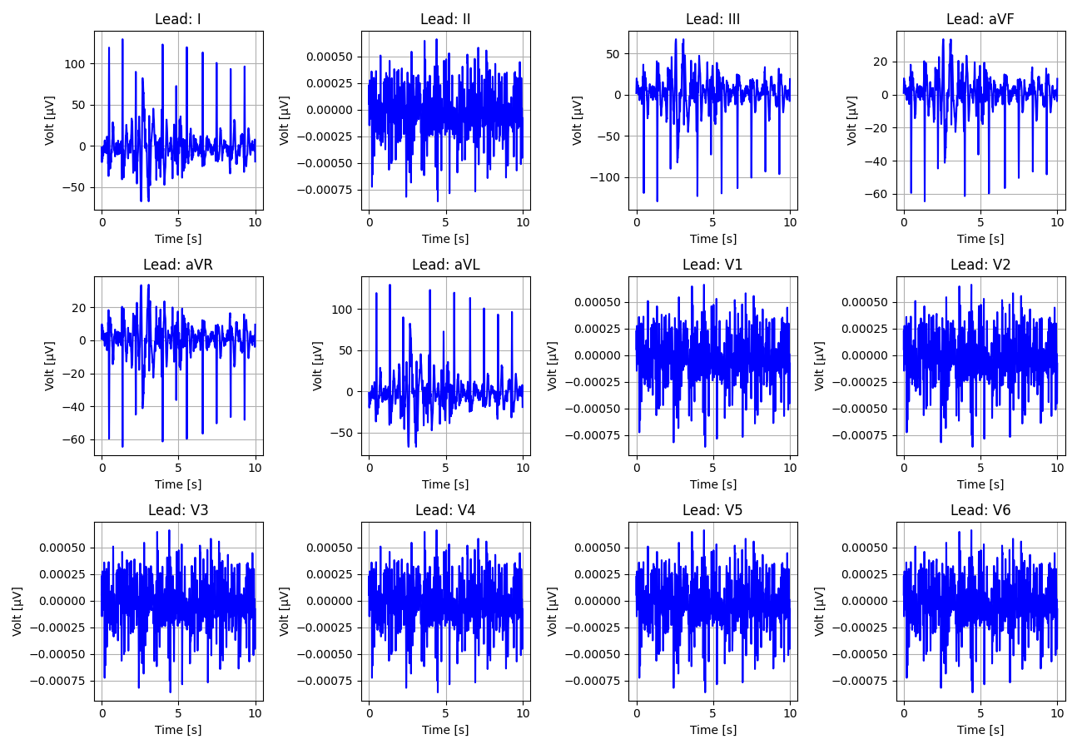
5_Recording_1568146

Slide 6
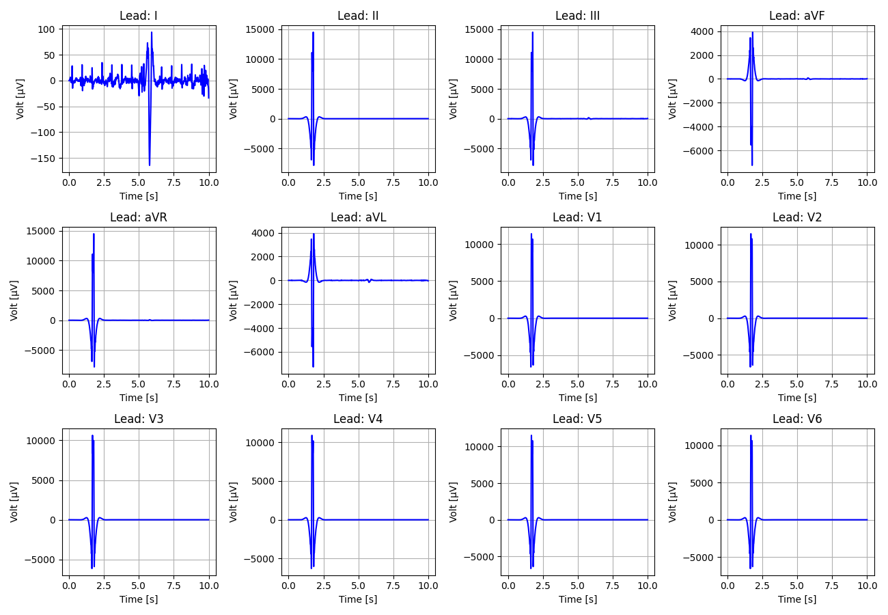
6_Recording_1553541

Slide 7
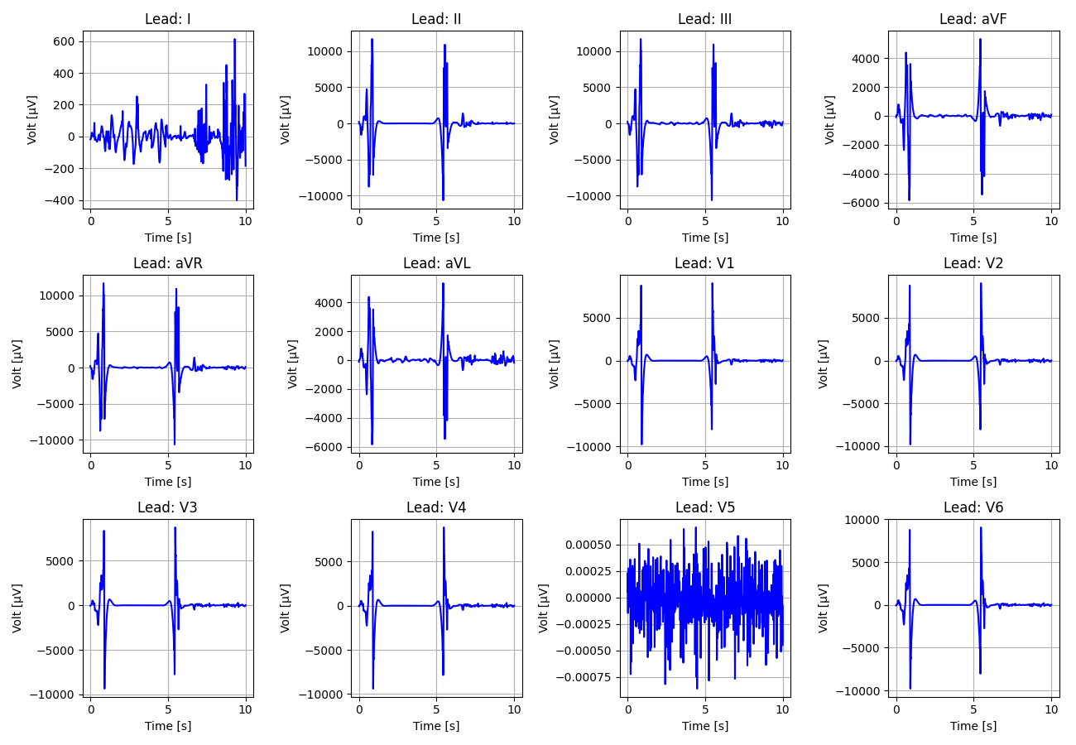
7_Recording_2326500

Slide 8
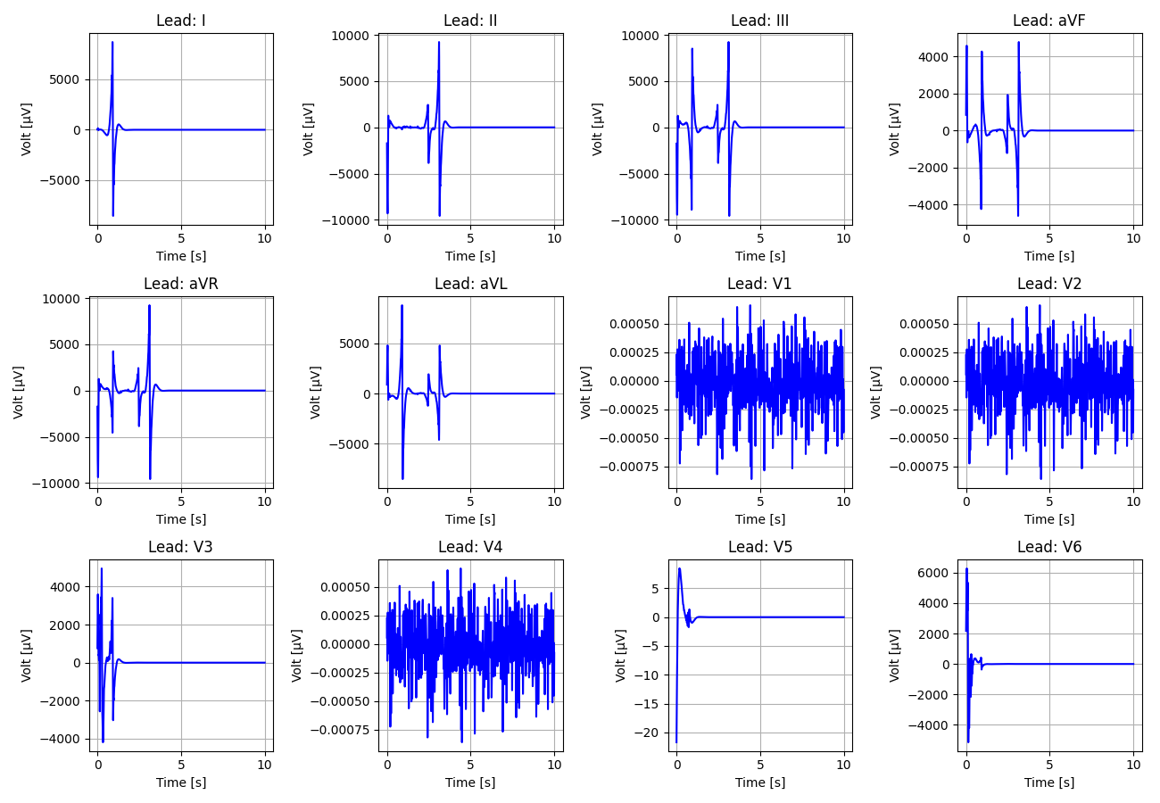
8_Recording_2936700

Slide 9
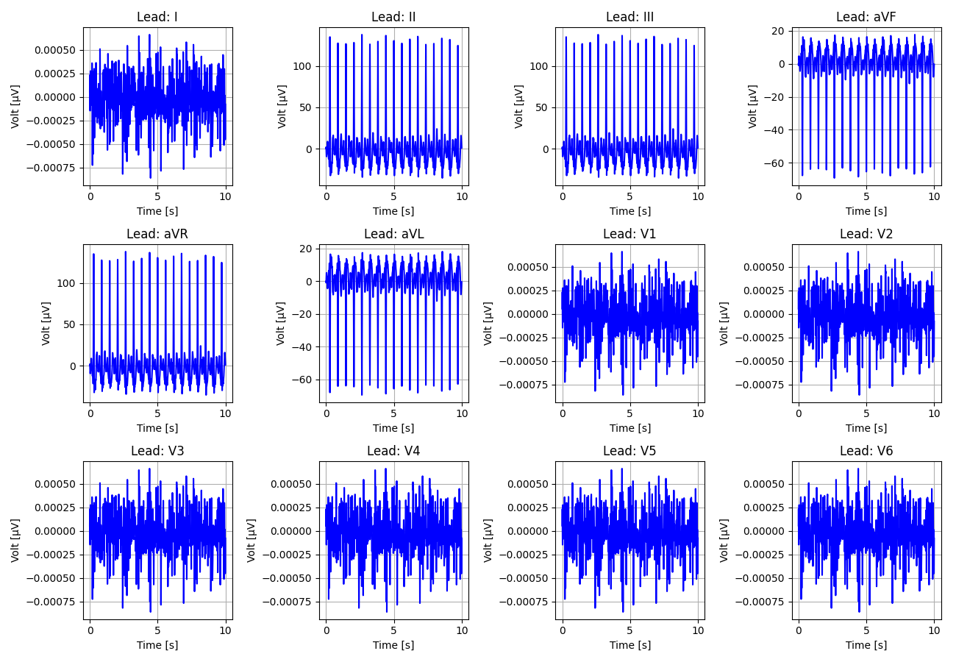
9_Recording_1836026

Slide 10
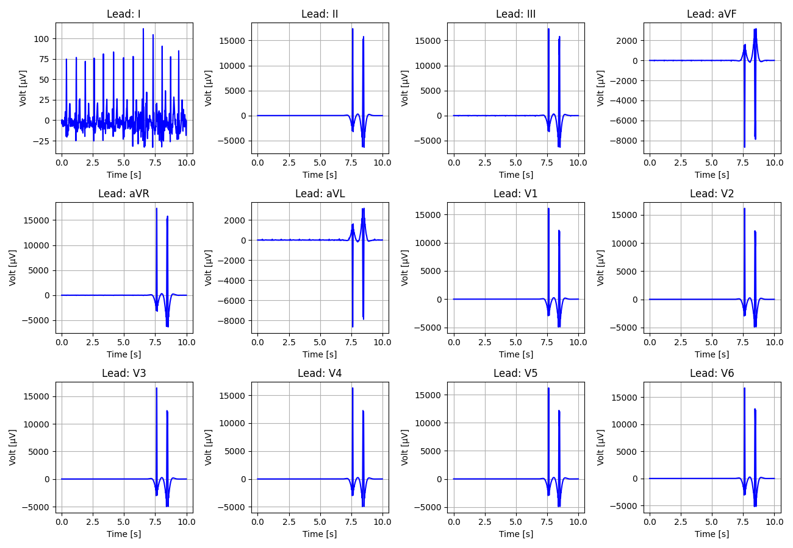
10_Recording_2327647

Slide 11
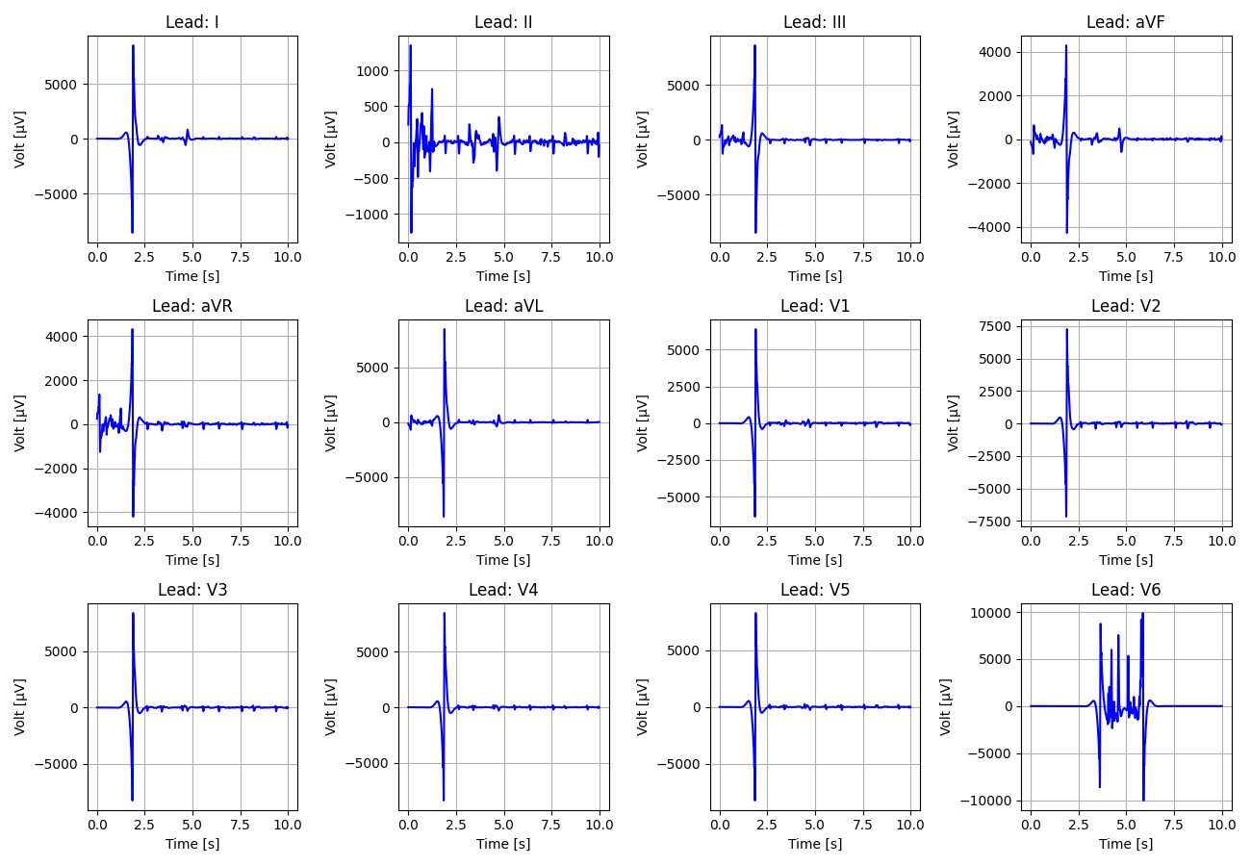
11_Recording_1610034

Slide 12
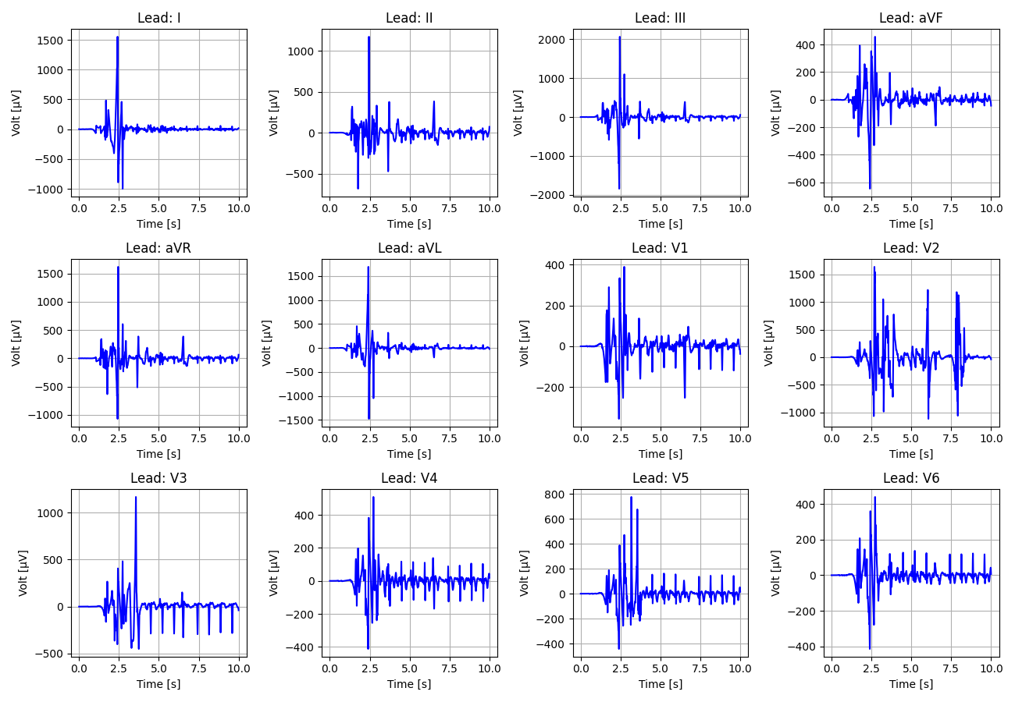
12_Recording_1816501

Slide 13
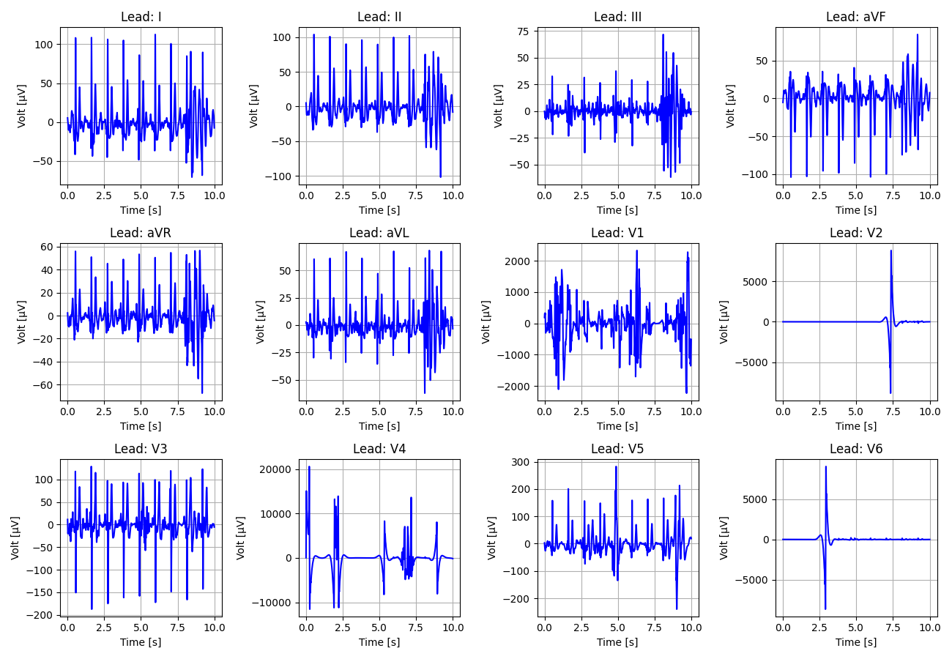
13_Recording_1953759

Slide 14
14_Recording_2428298

Slide 15
15_Recording_2110250

Slide 16
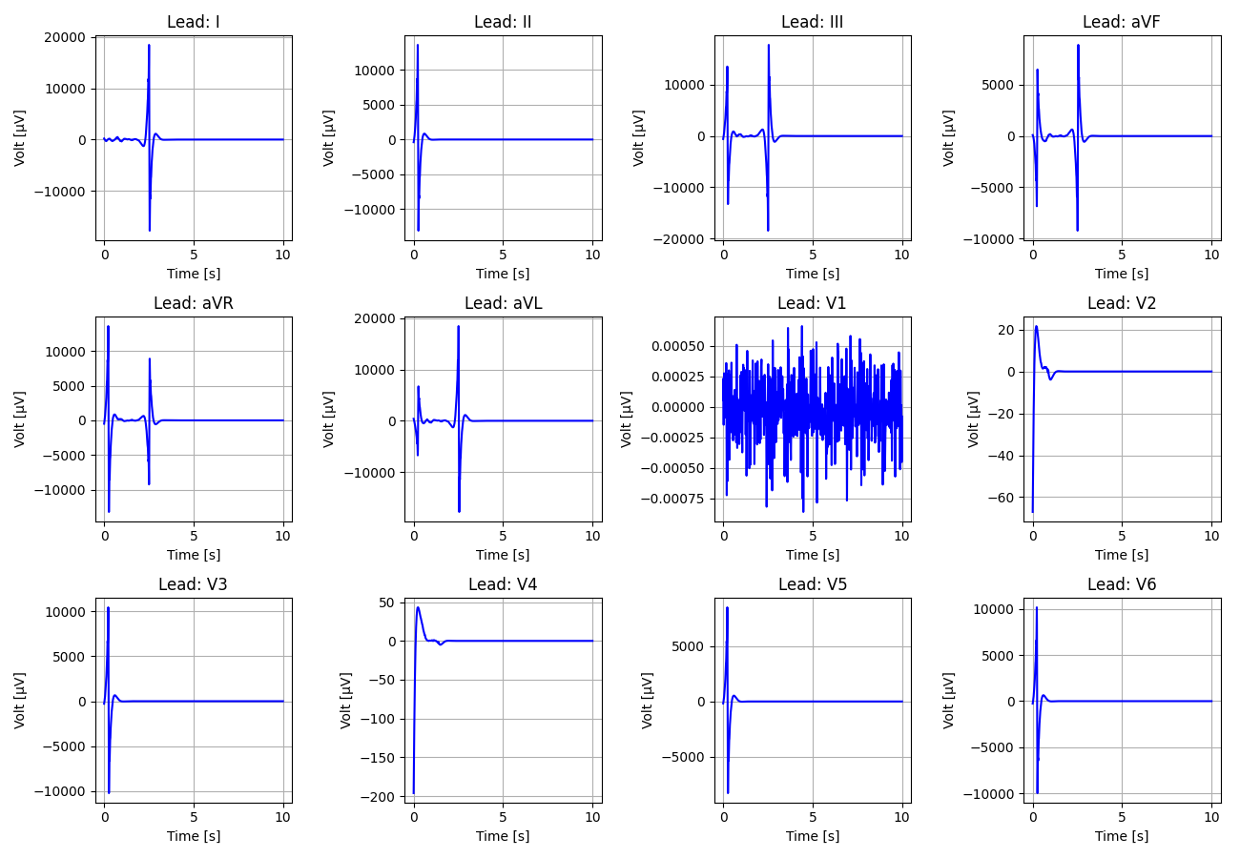
16_Recording_2098595

Slide 17
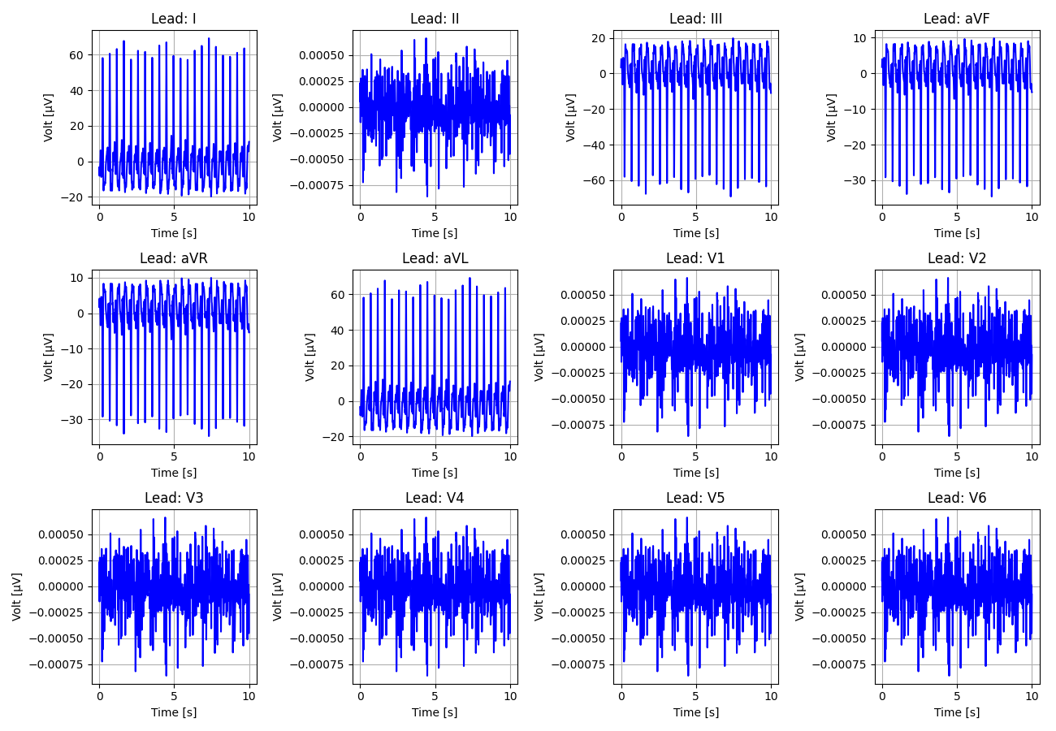
17_Recording_1335760

Slide 18
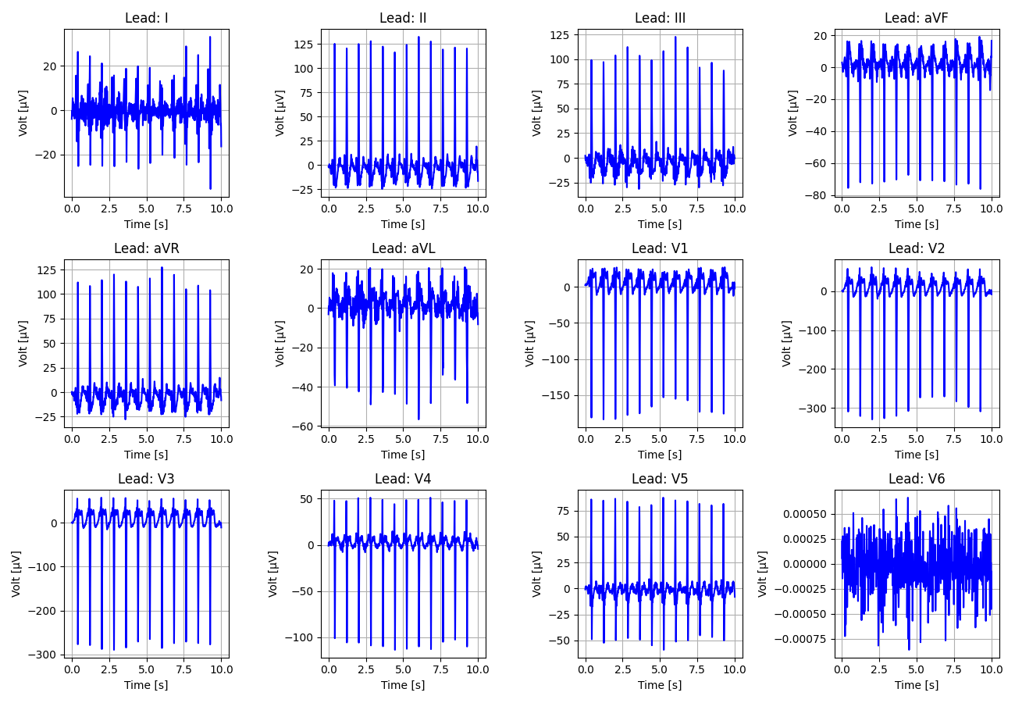
18_Recording_1028102

Slide 19
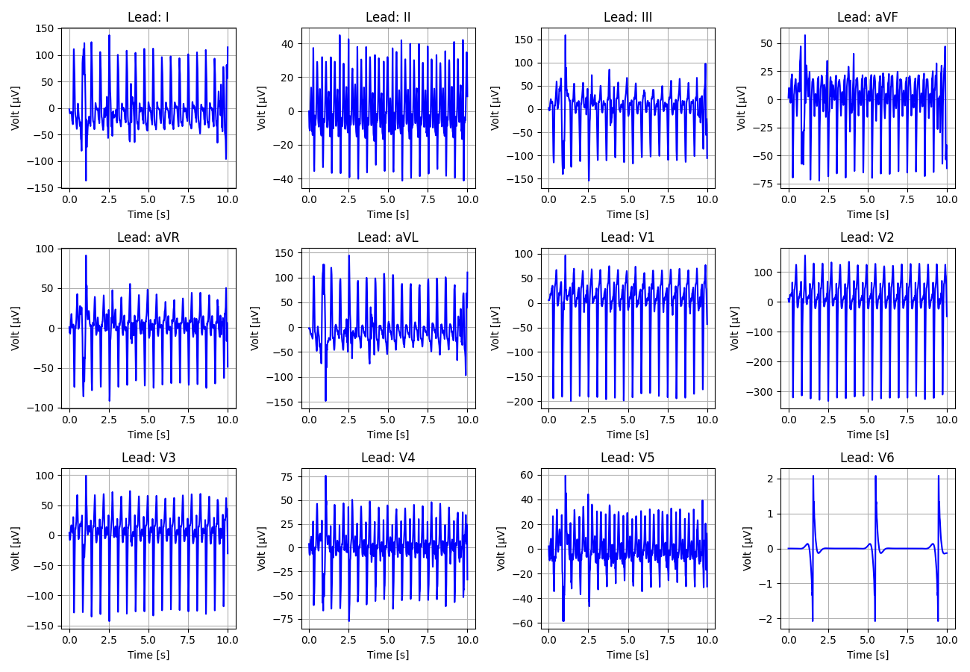
19_Recording_1607439

Slide 20
20_Recording_1777141

Slide 21
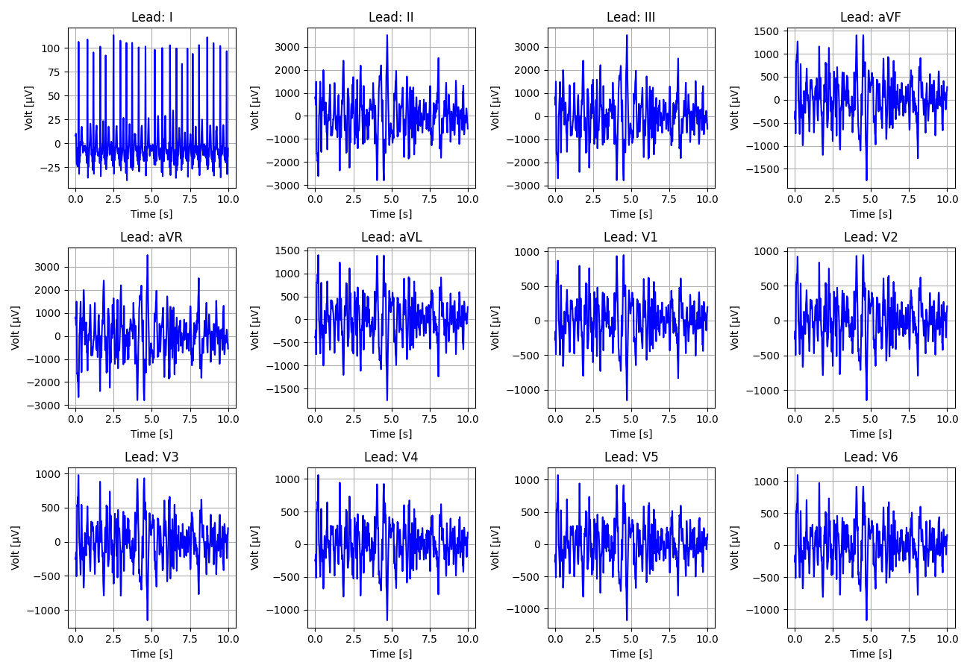
21_Recording_2849336

Slide 22
22_Recording_1295738

Slide 23
23_Recording_1364918

Slide 24
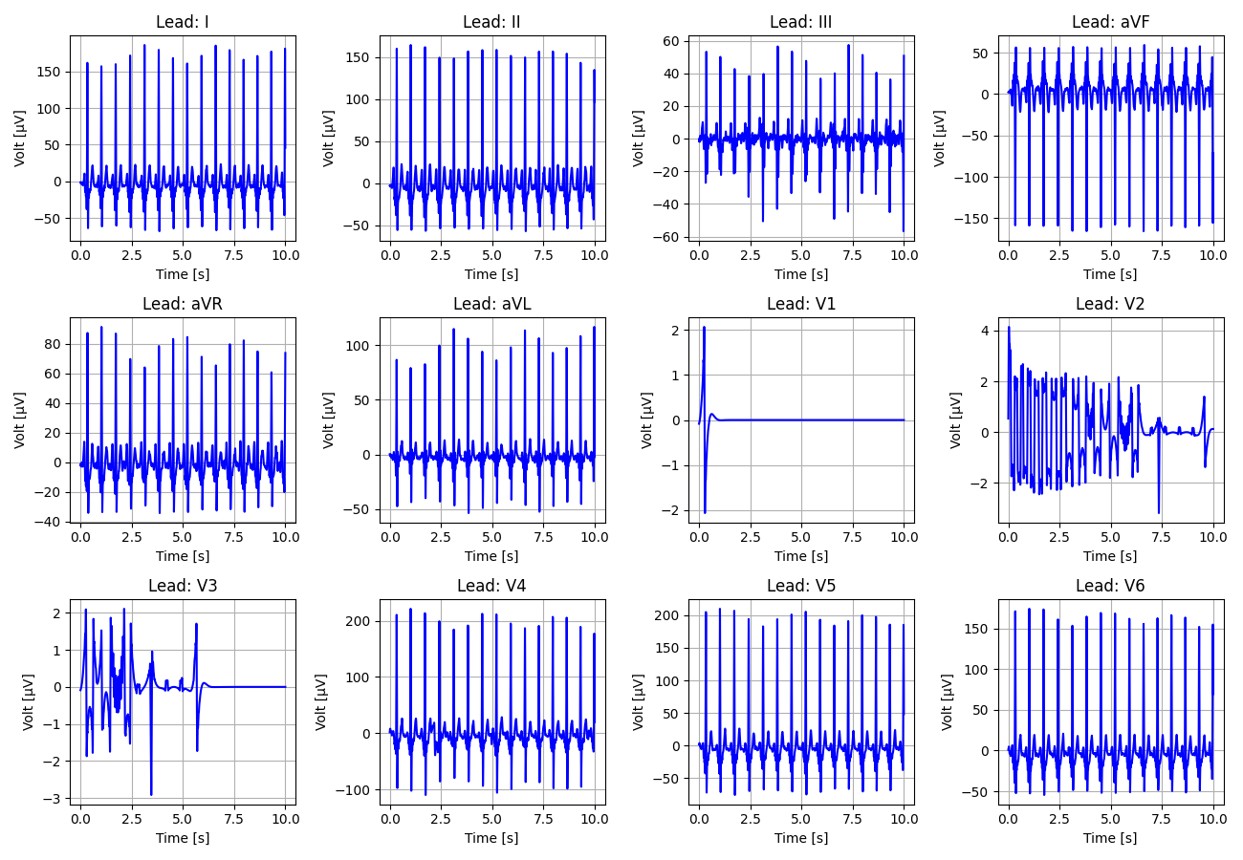
24_Recording_1980306

Slide 25
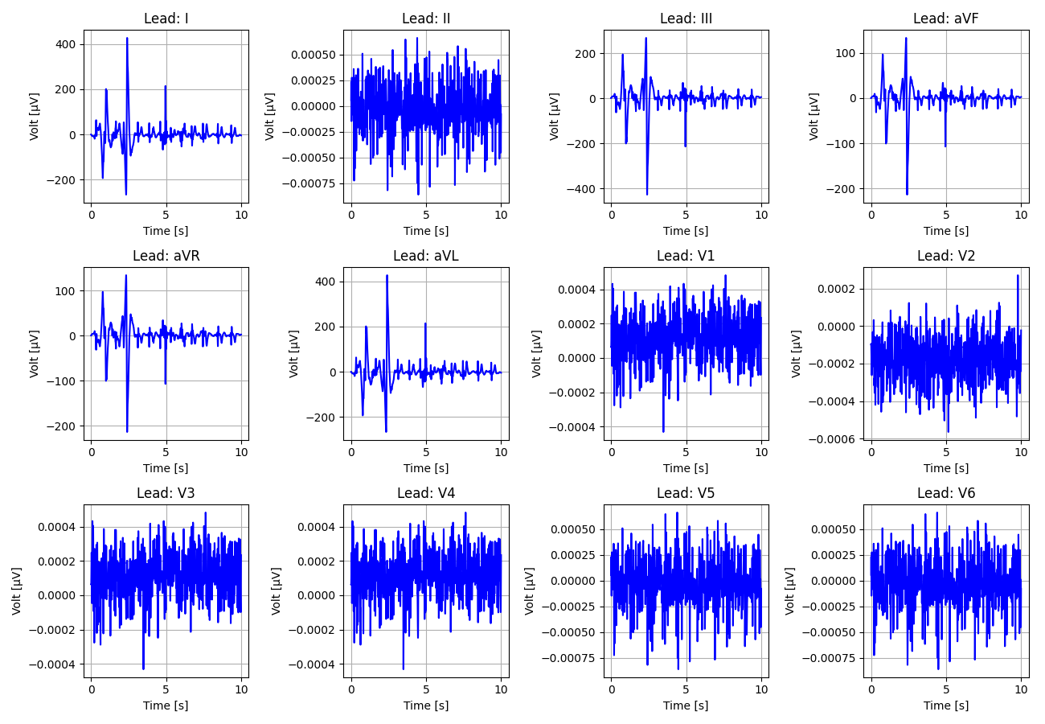
25_Recording_1063073

Slide 26
26_Recording_2834490

Slide 27
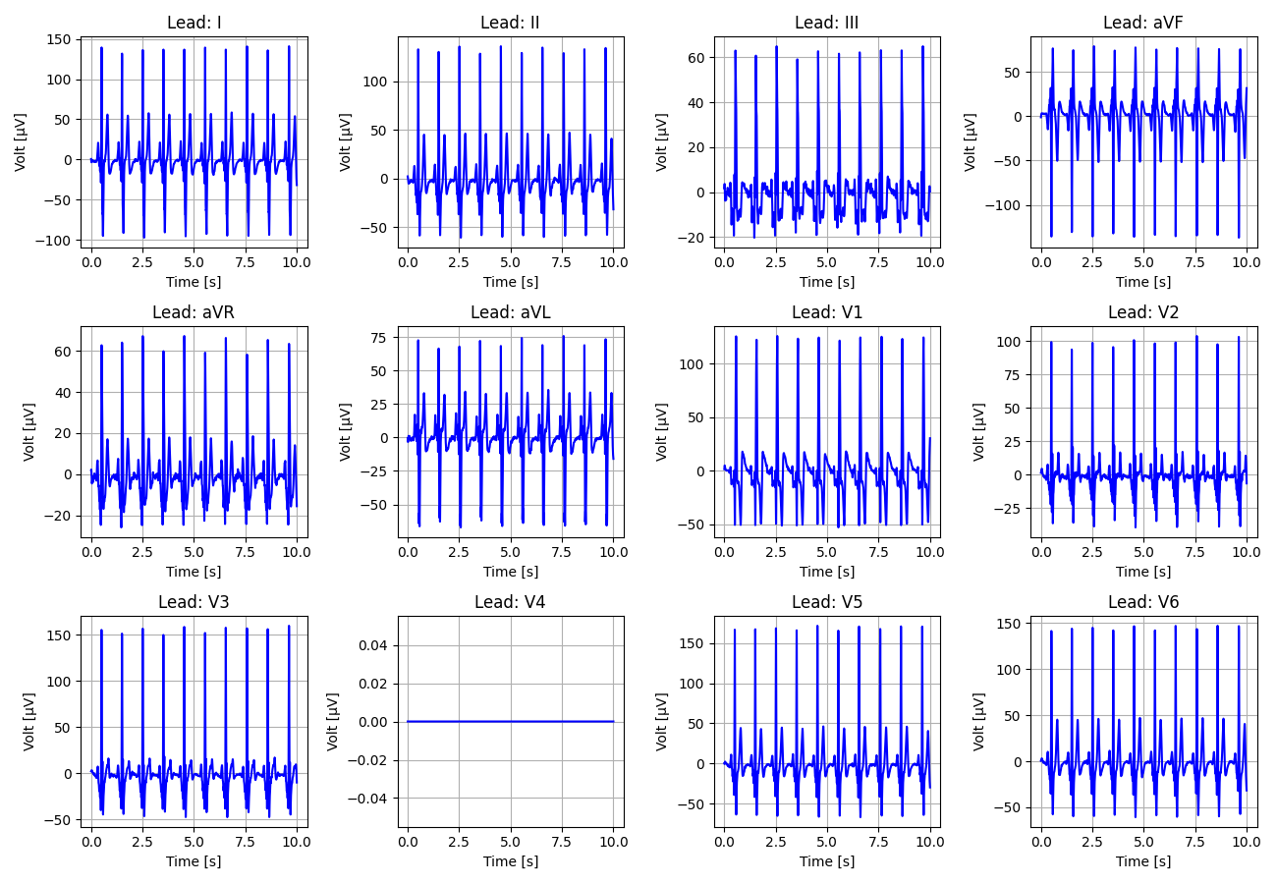
27_Recording_1221733

Slide 28
28_Recording_1079854

Slide 29
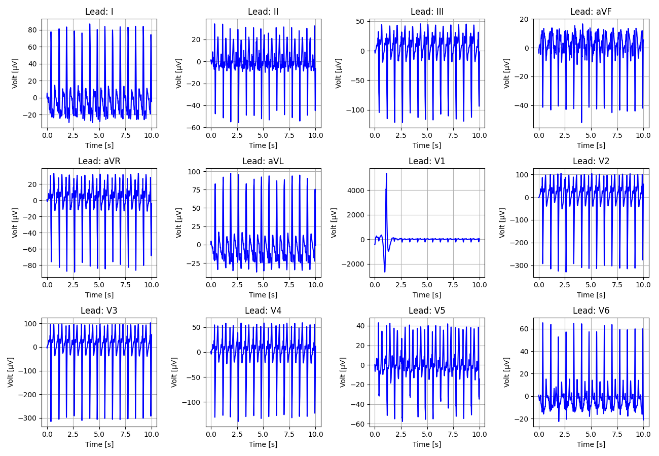
29_Recording_1451509

Slide 30
30_Recording_2111450

Slide 31
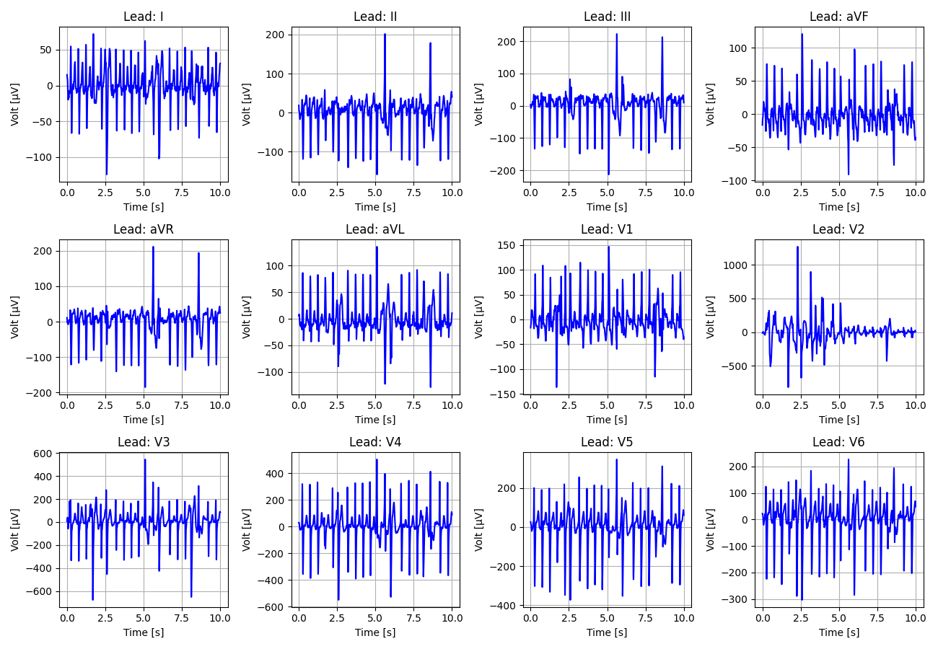
31_Recording_1004502

Slide 32
32_Recording_2251502

Slide 33
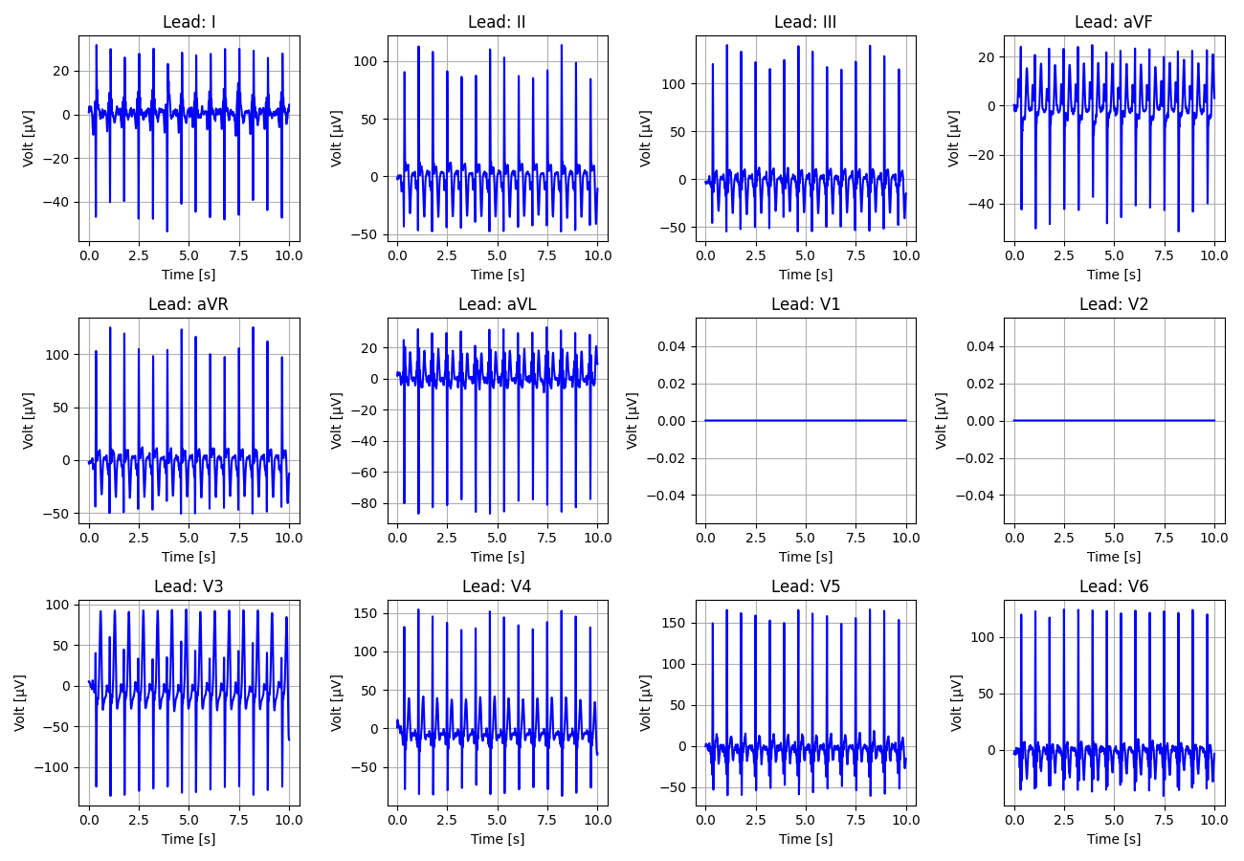
33_Recording_1490937

Slide 34
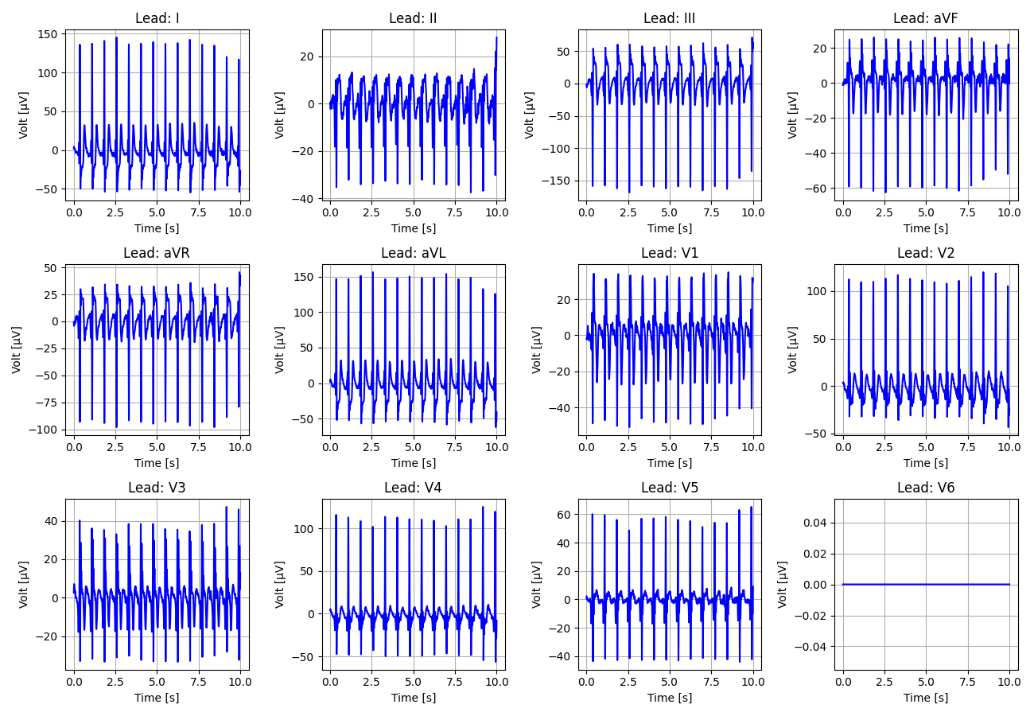
34_Recording_1068152

Slide 35
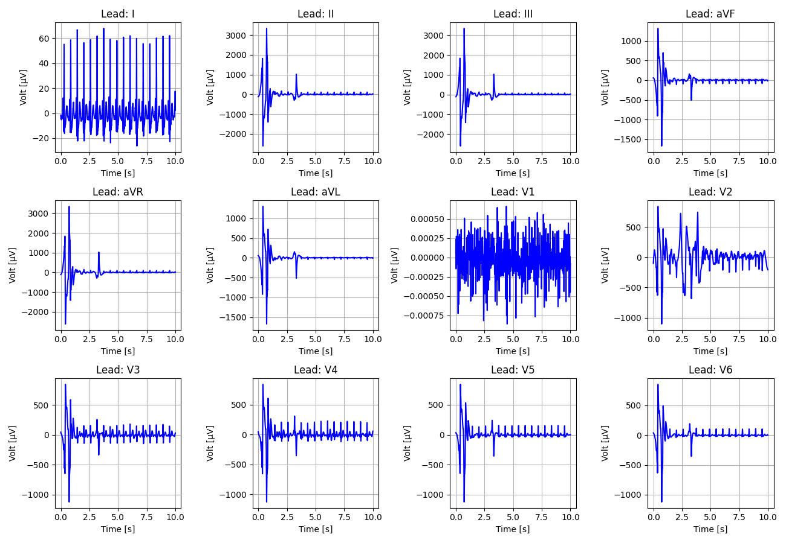
35_Recording_1795070

Slide 36
36_Recording_1661380

Slide 37
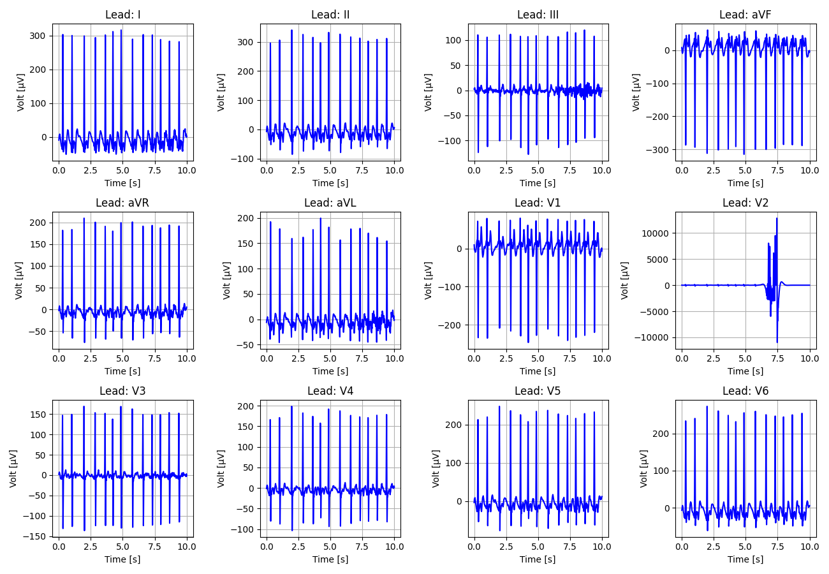
37_Recording_1509036

Slide 38
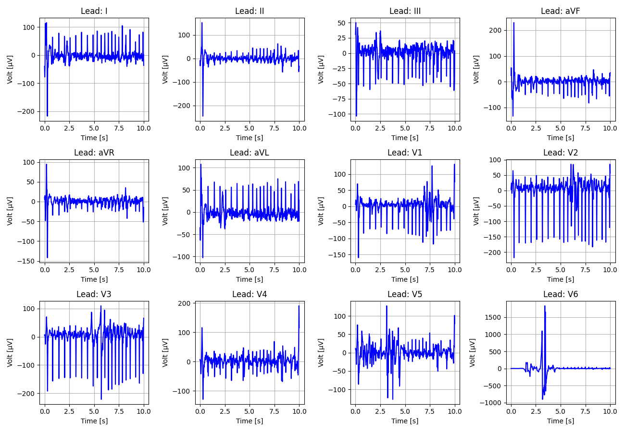
38_Recording_1356529

Slide 39
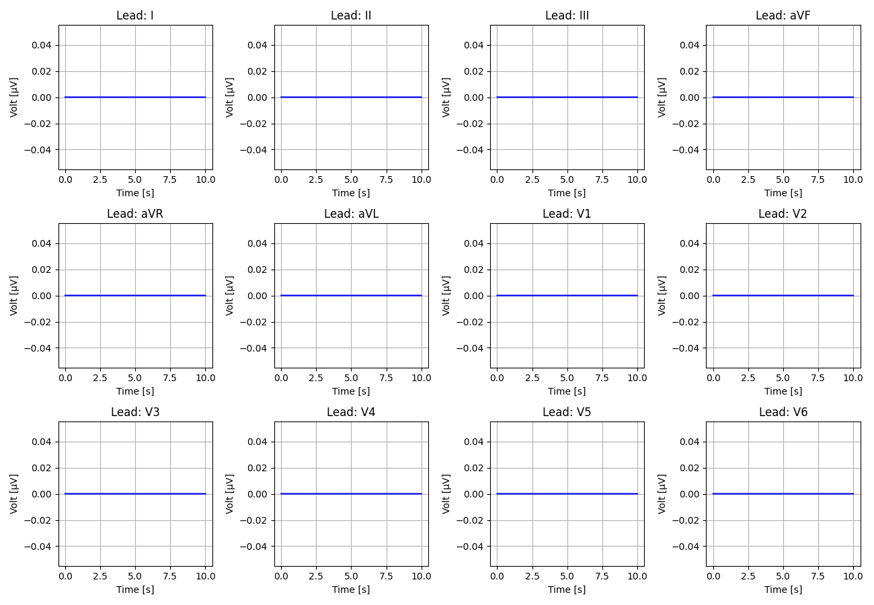
39_Recording_2338564

Slide 40
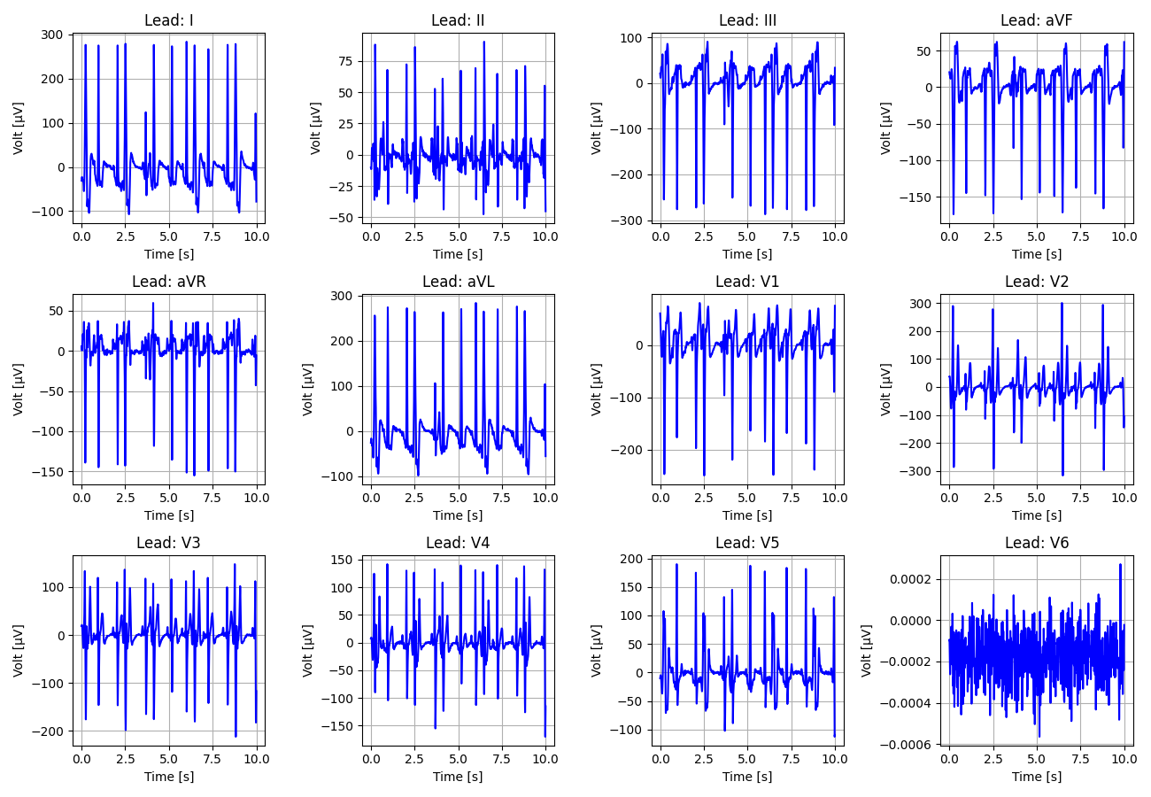
40_Recording_1819445

Slide 41
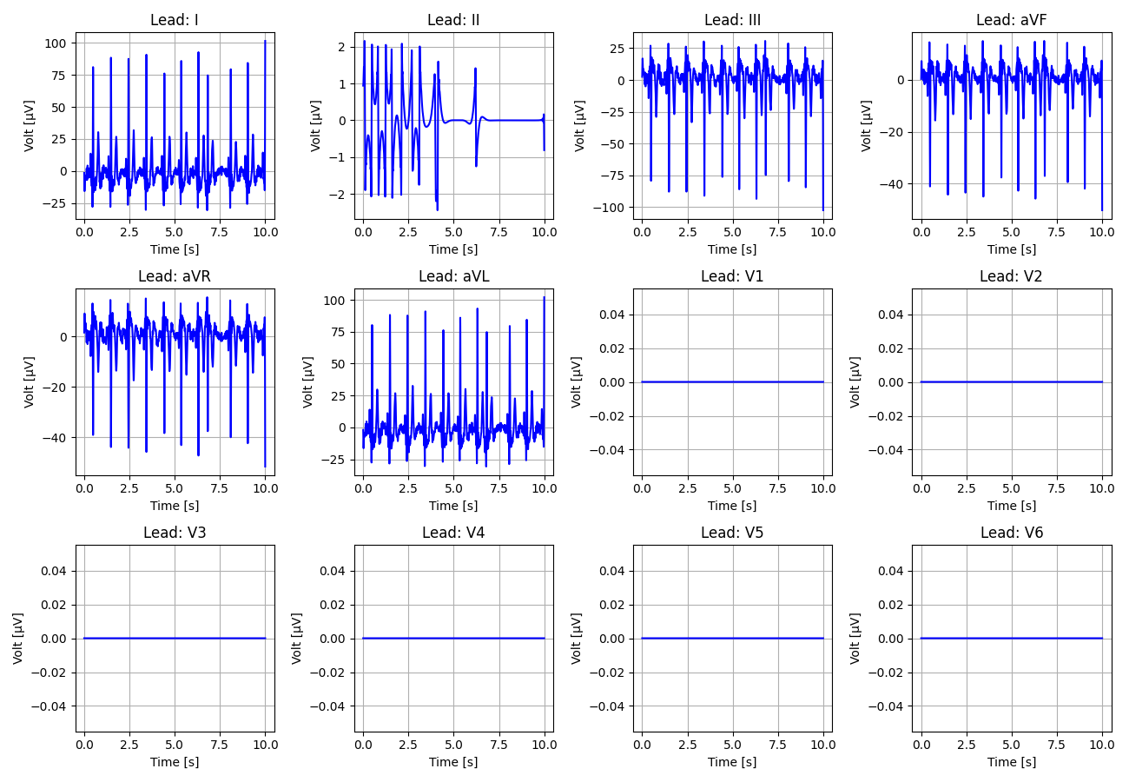
41_Recording_2484180

Slide 42
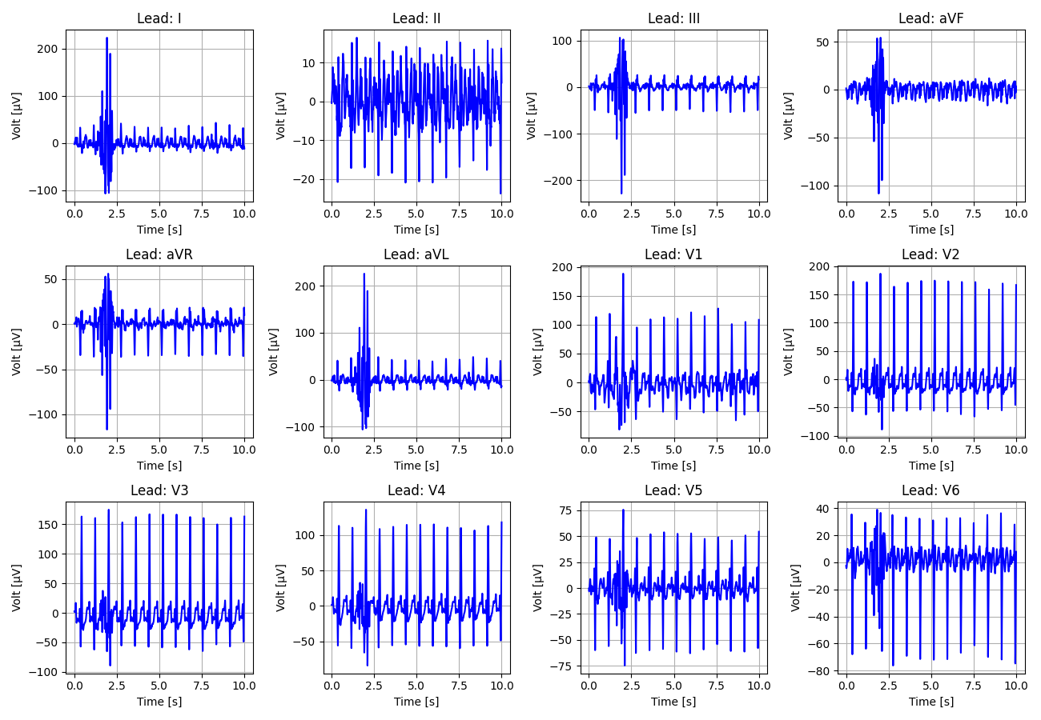
42_Recording_1169320

Slide 43
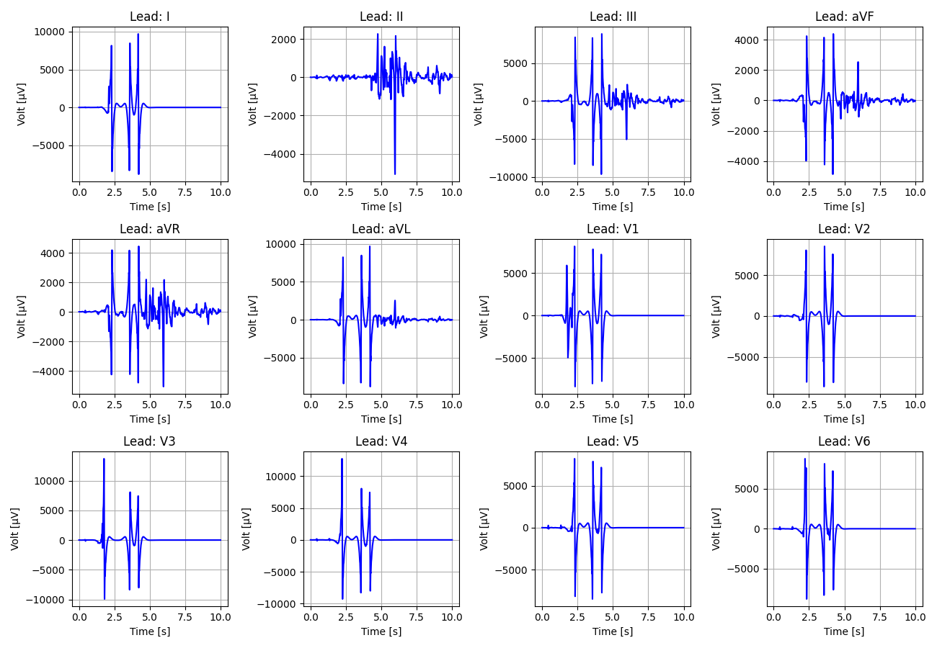
43_Recording_2845888

Slide 44
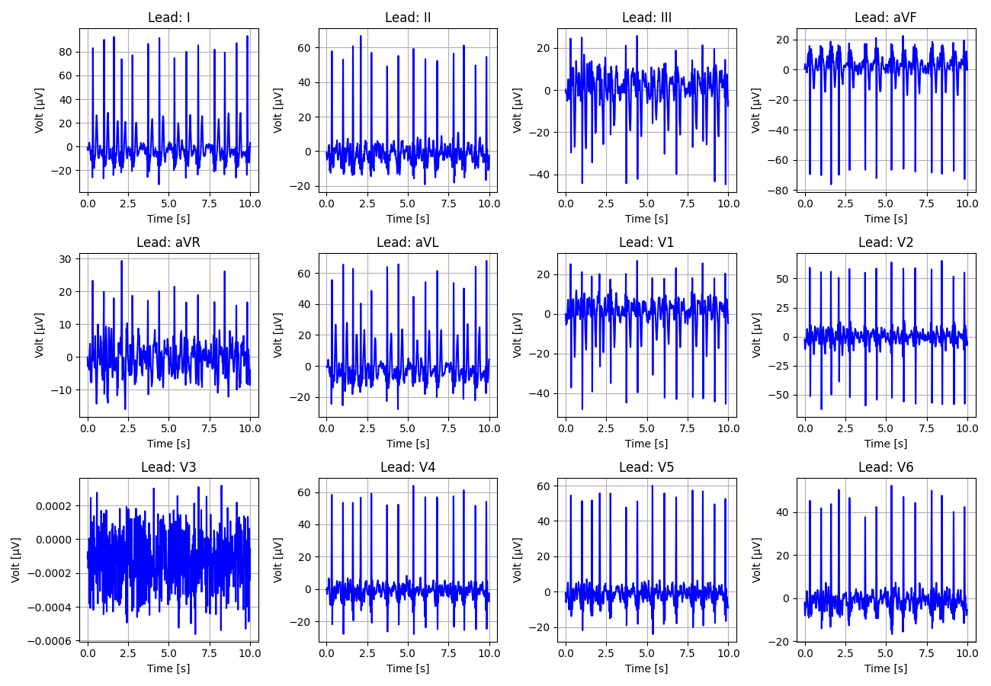
44_Recording_2329269

Slide 45
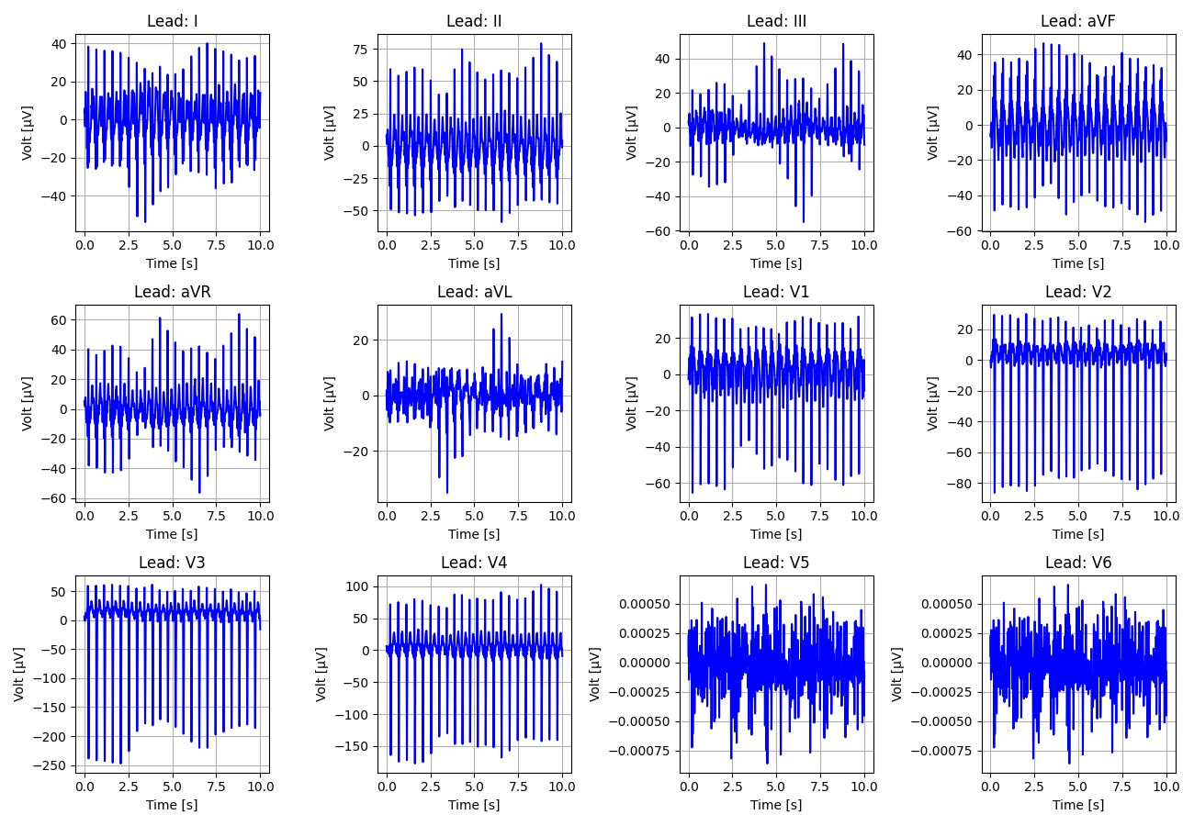
45_Recording_1192090

Slide 46
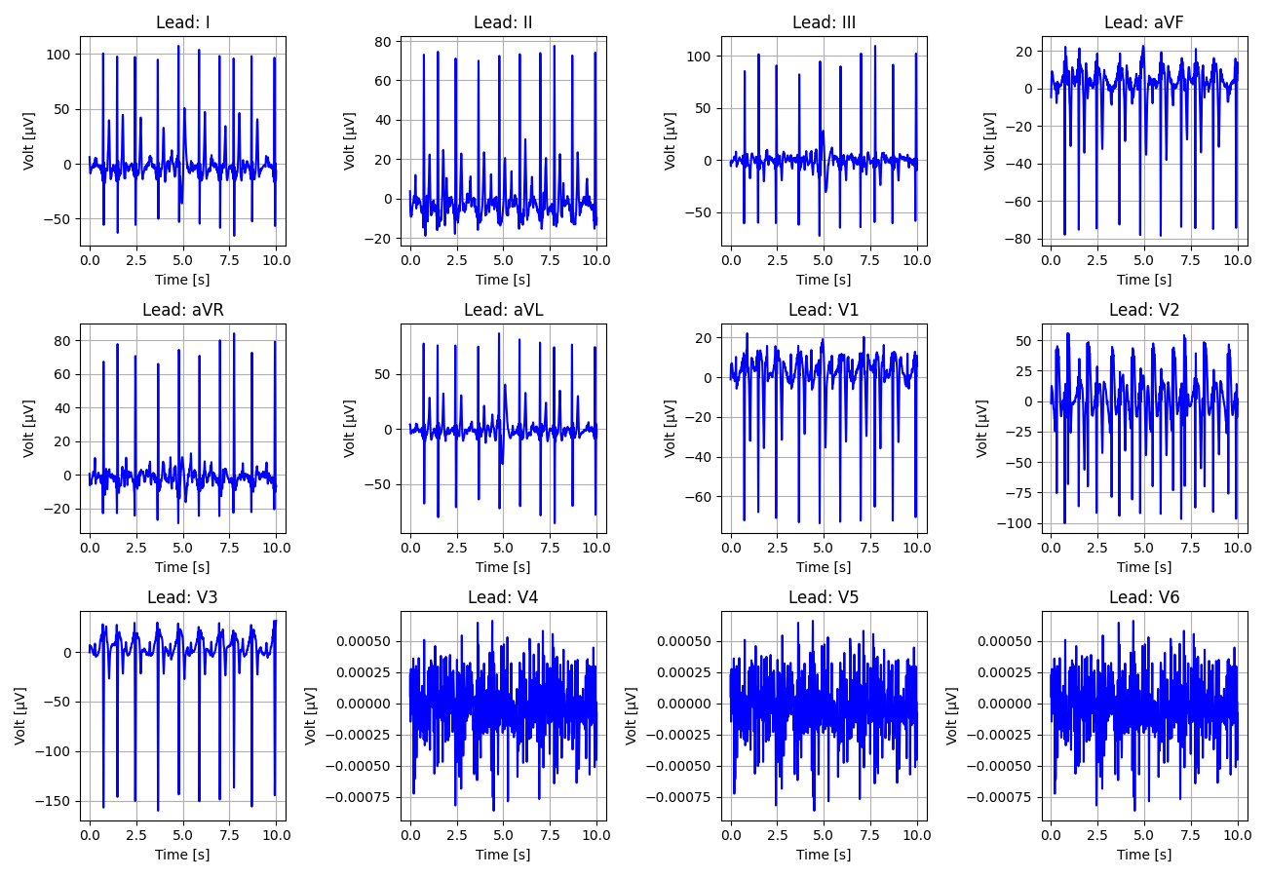
46_Recording_2429146

Slide 47
47_Recording_1485621

Slide 48
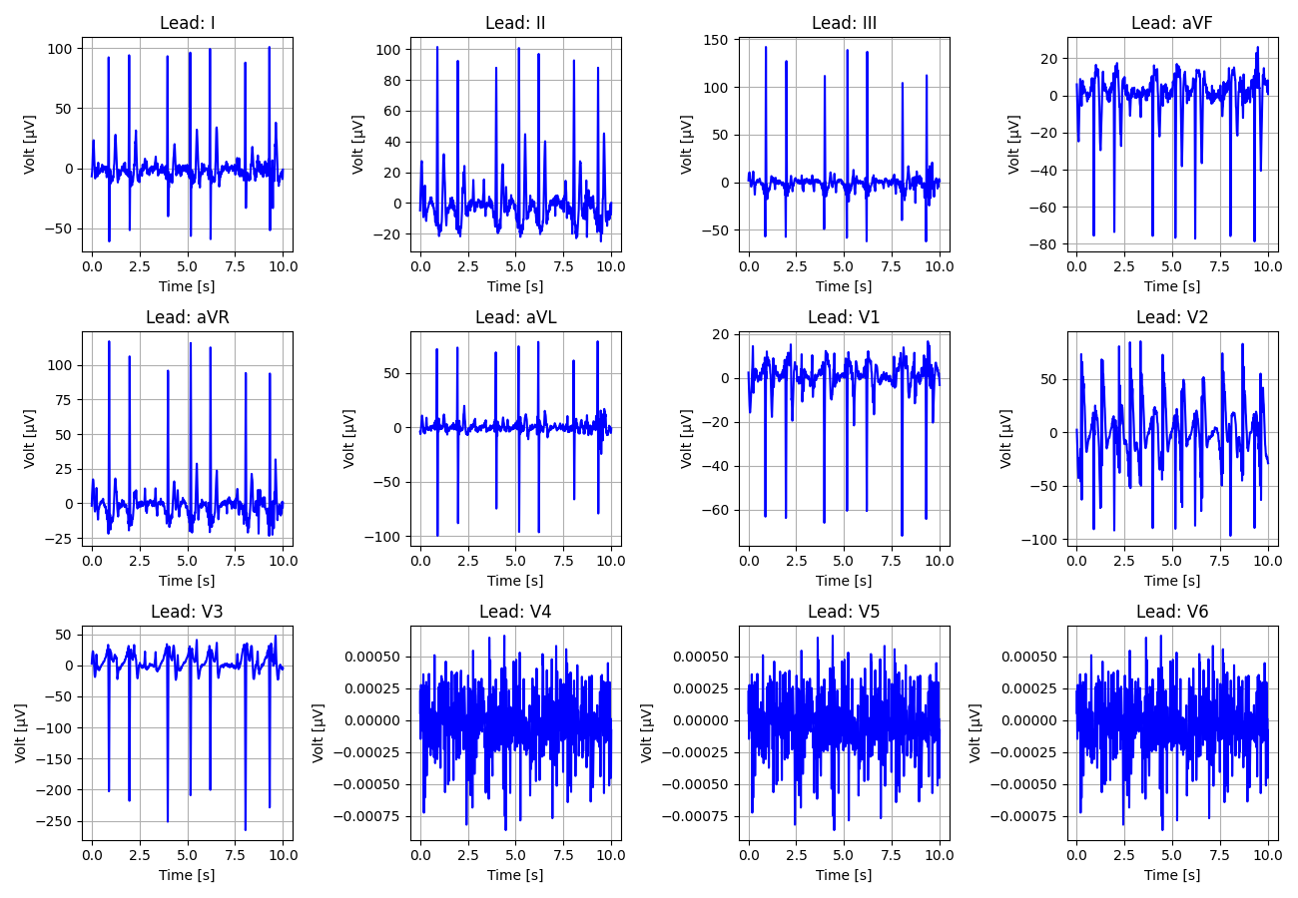
48_Recording_2368502

Slide 49
49_Recording_1770220

Slide 50
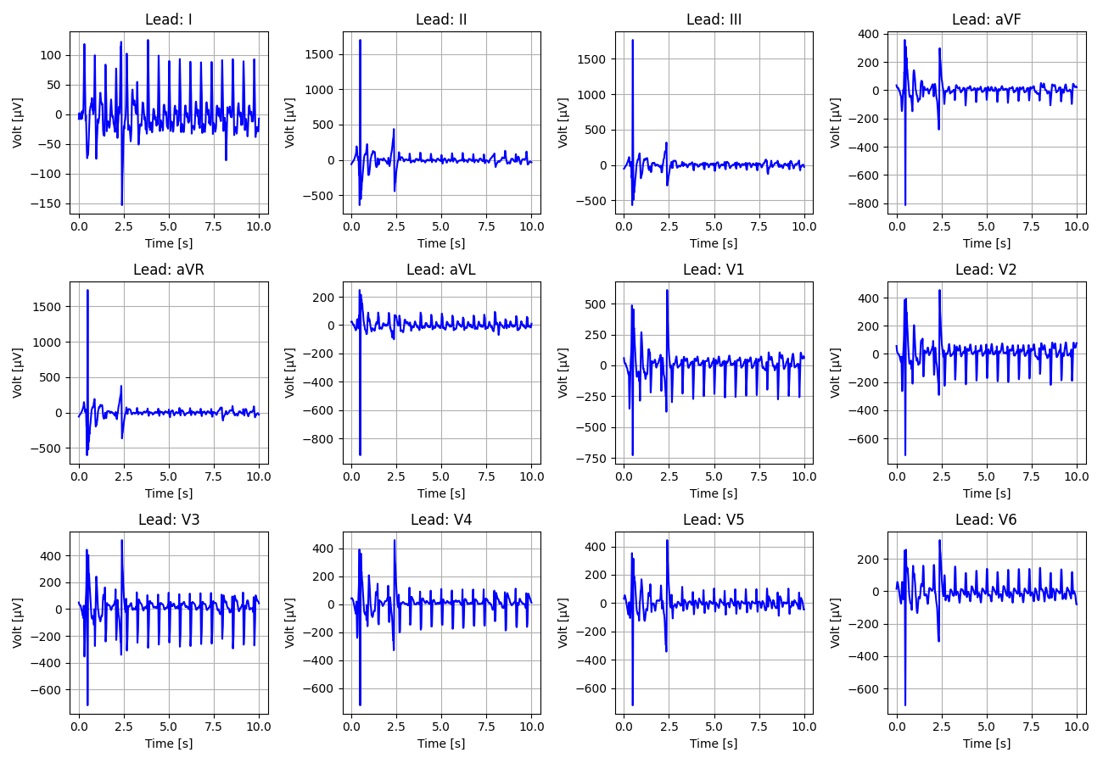
50_Recording_1961627

Slide 51
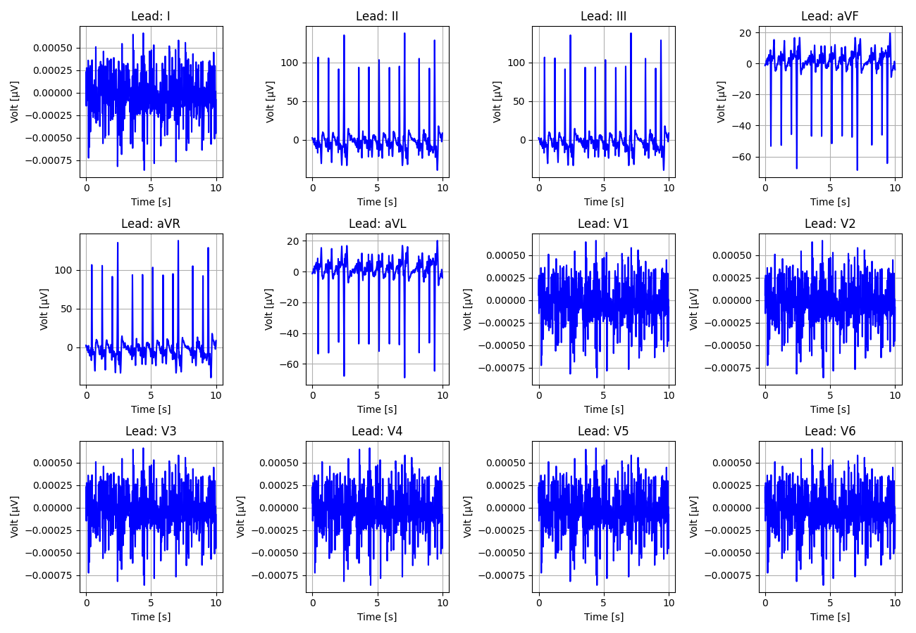
51_Recording_1906060

Slide 52
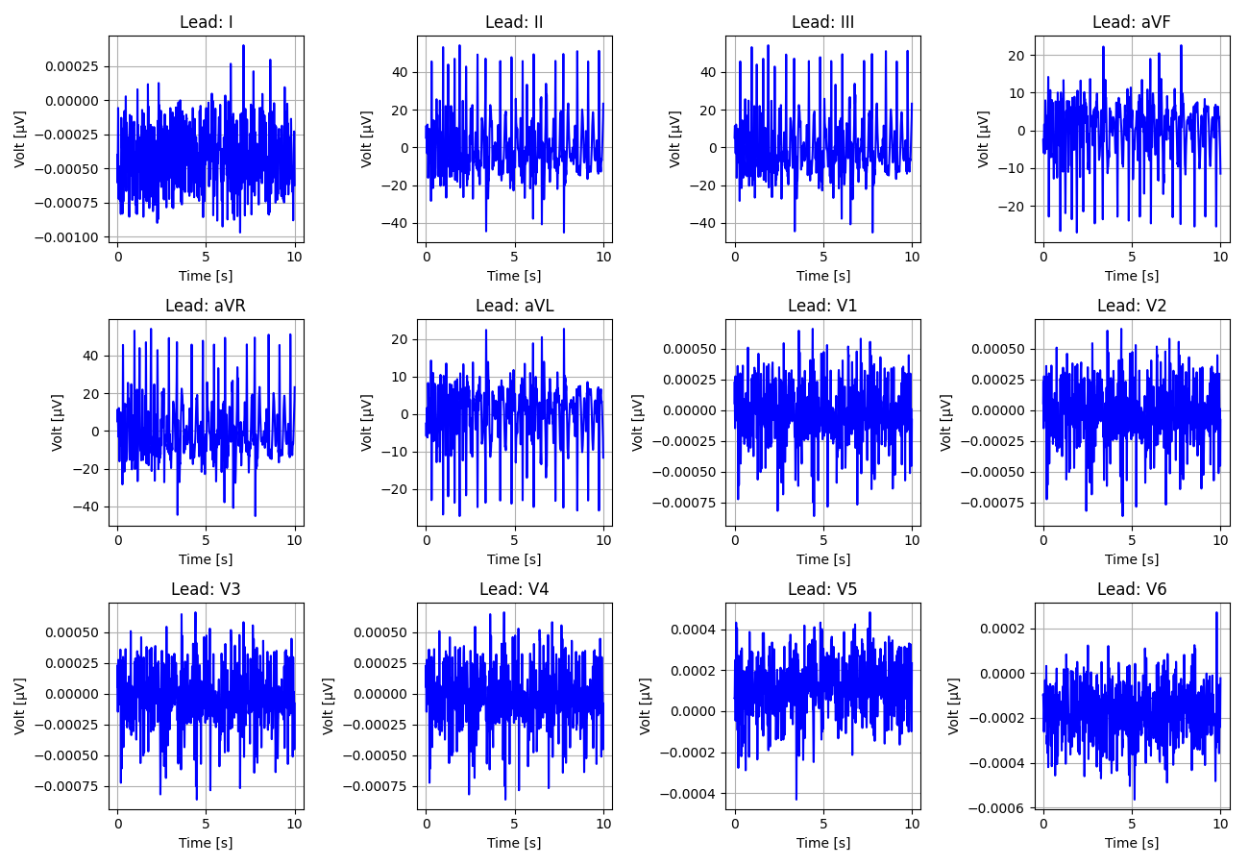
52_Recording_2140359

Slide 53
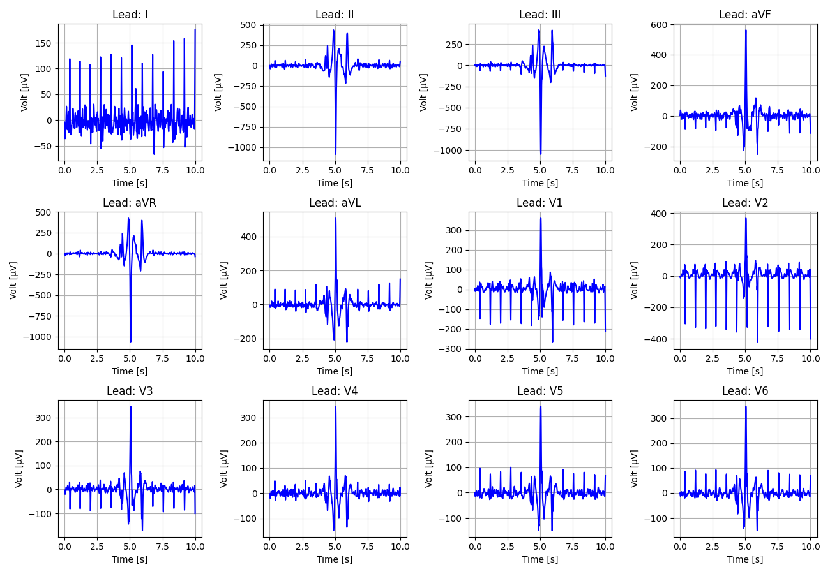
53_Recording_2145403

Slide 54
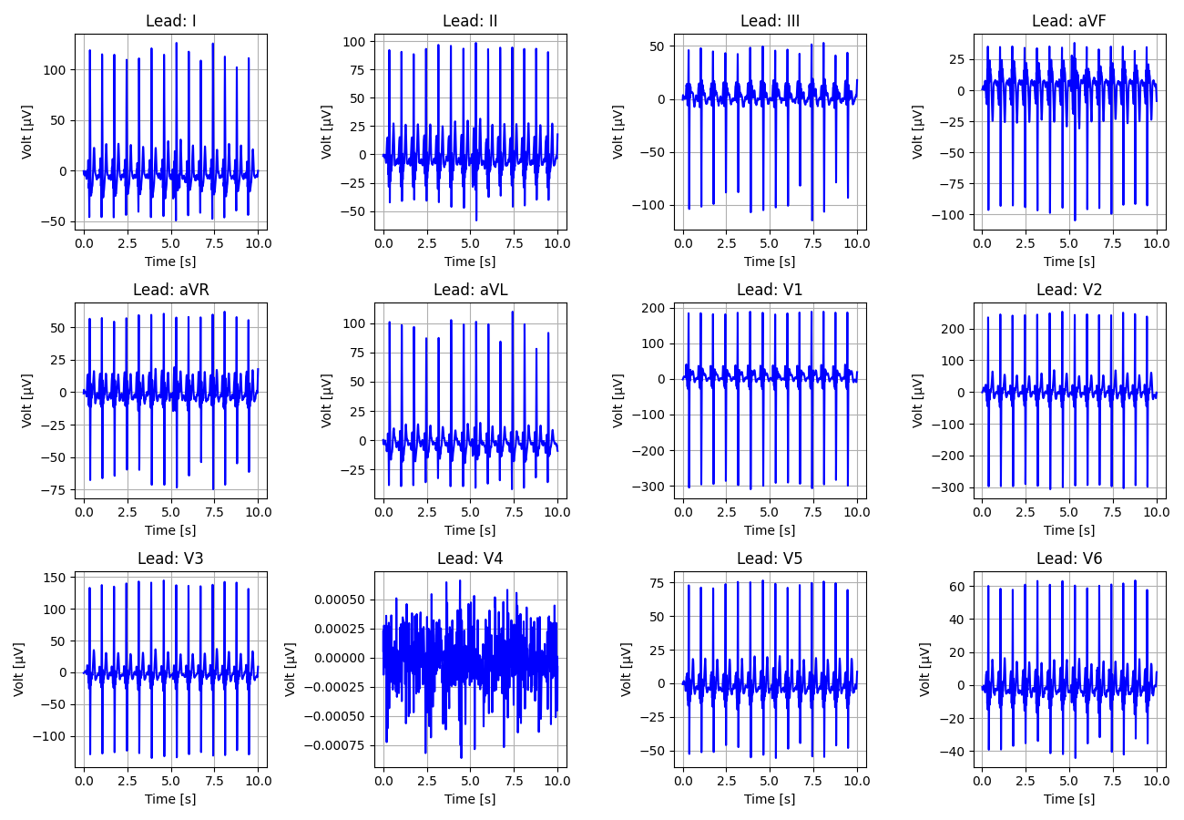
54_Recording_1163558

Slide 55
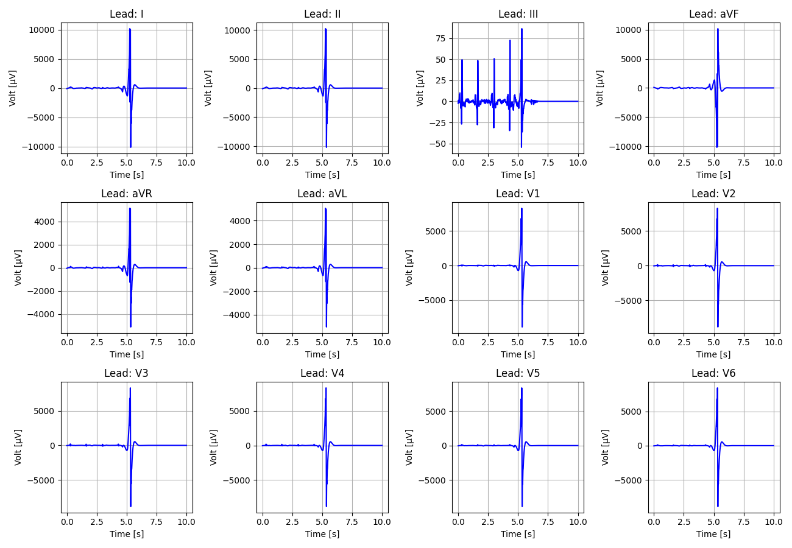
55_Recording_2271513

Slide 56
56_Recording_2420975

Slide 57
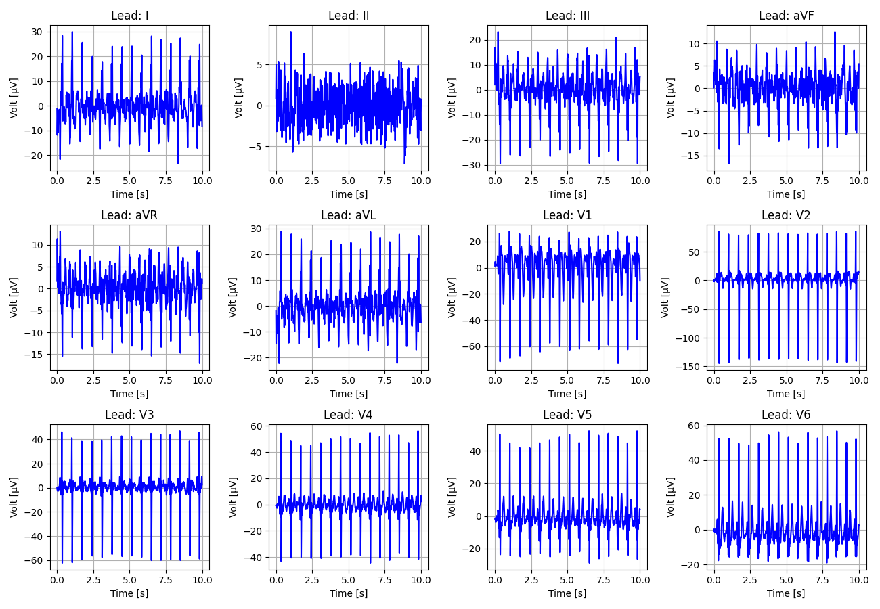
57_Recording_2151929

Slide 58
58_Recording_1852649

Slide 59
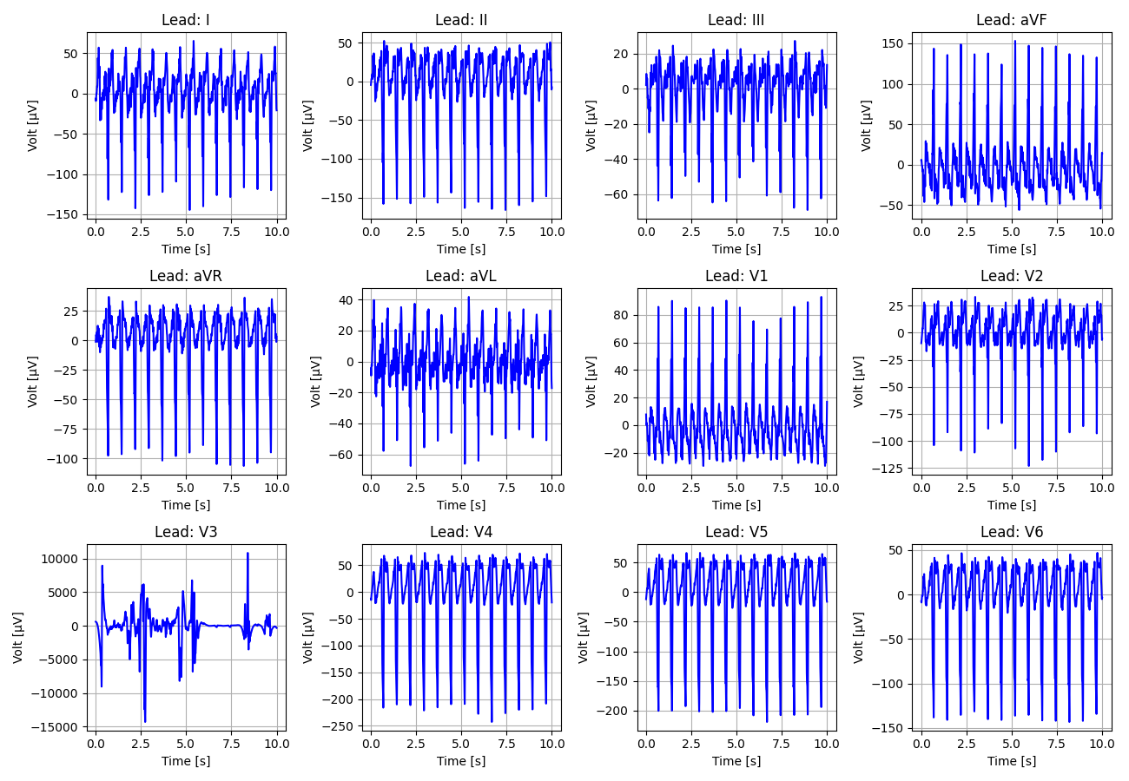
59_Recording_2367143

Slide 60
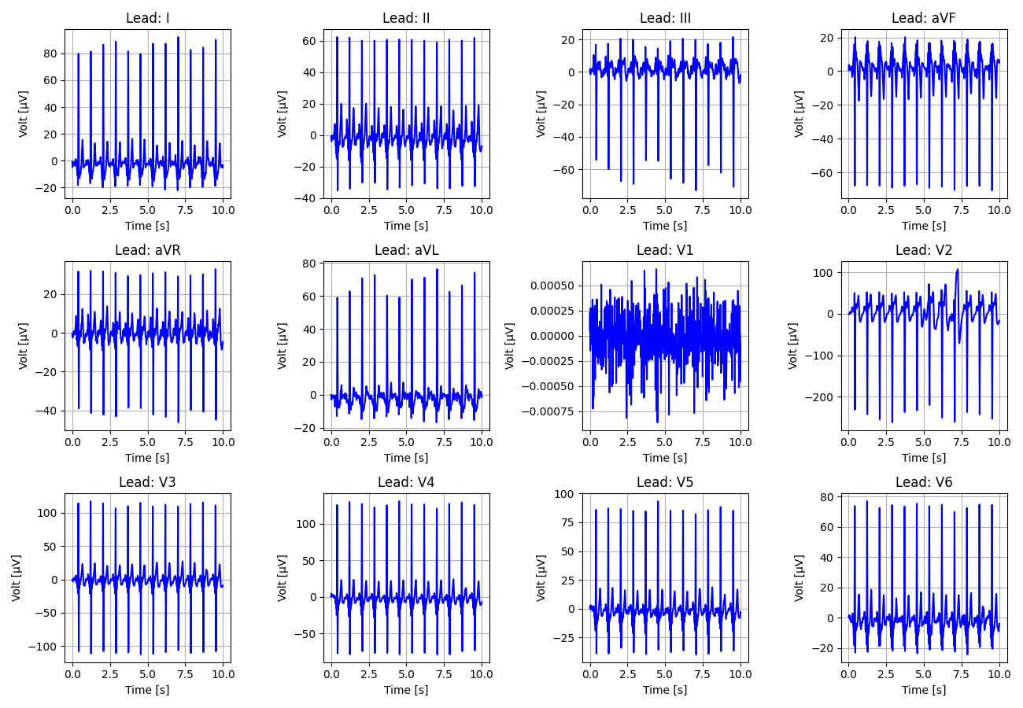
60_Recording_2544510

Slide 61
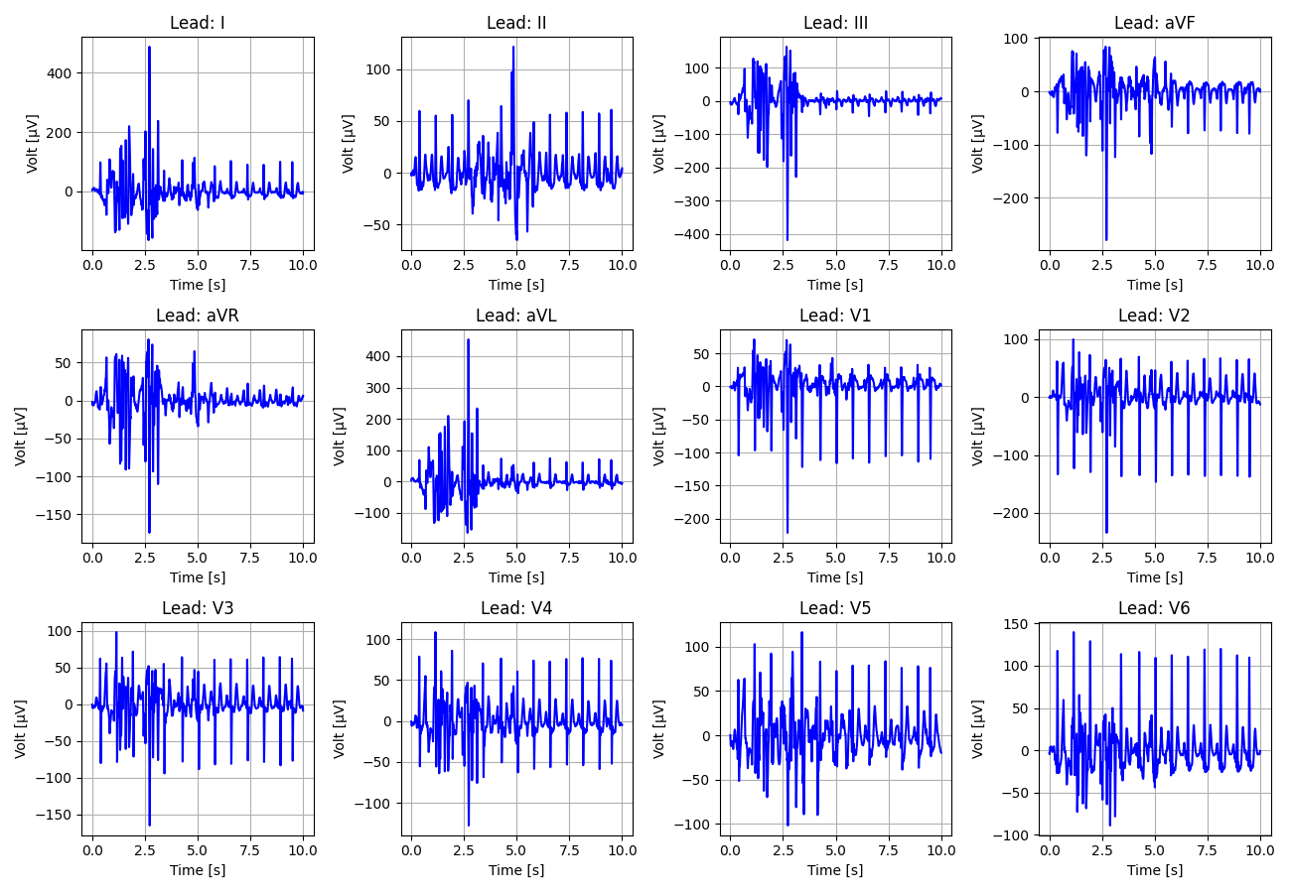
61_Recording_1138841

Slide 62
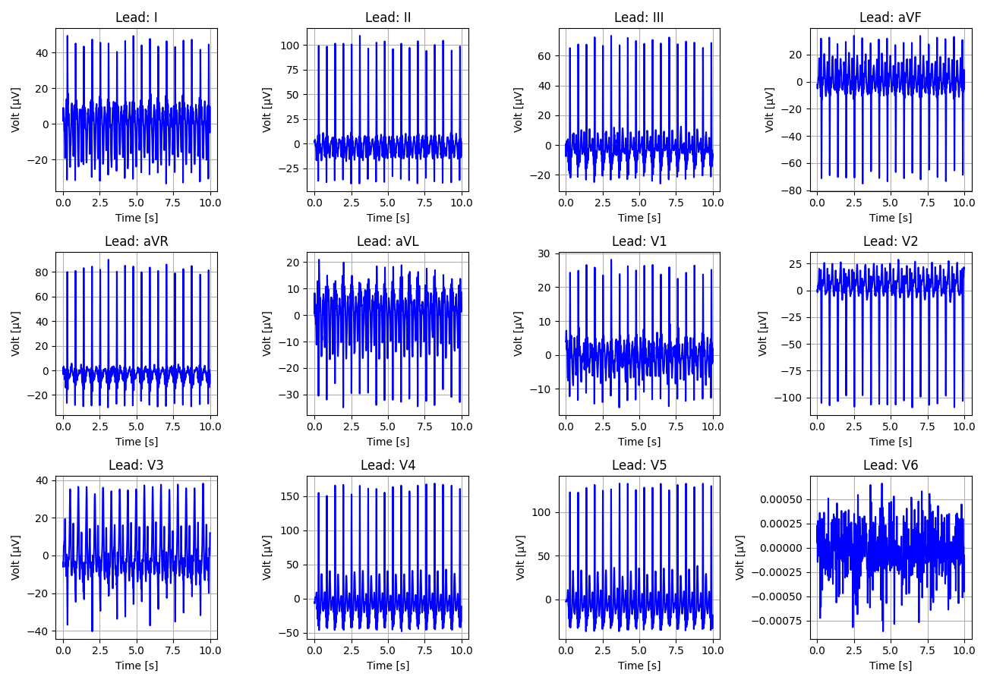
62_Recording_1943228

Slide 63
63_Recording_2540548

Slide 64
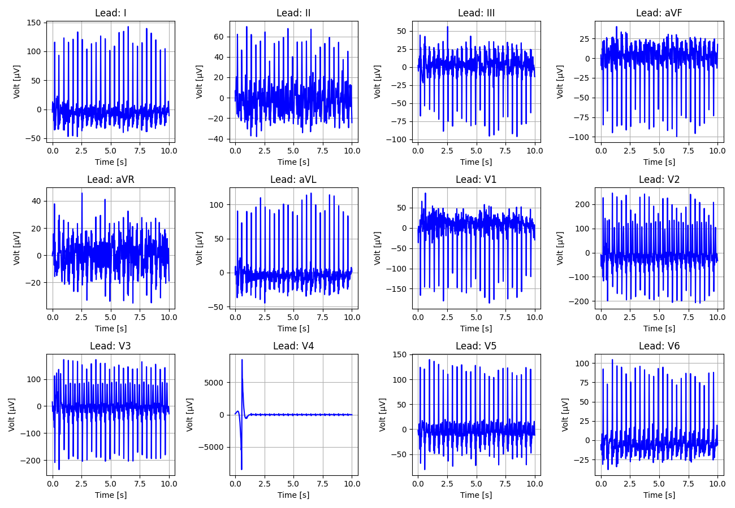
64_Recording_1356379

Slide 65
65_Recording_1425383

Slide 66
66_Recording_2052791

Slide 67
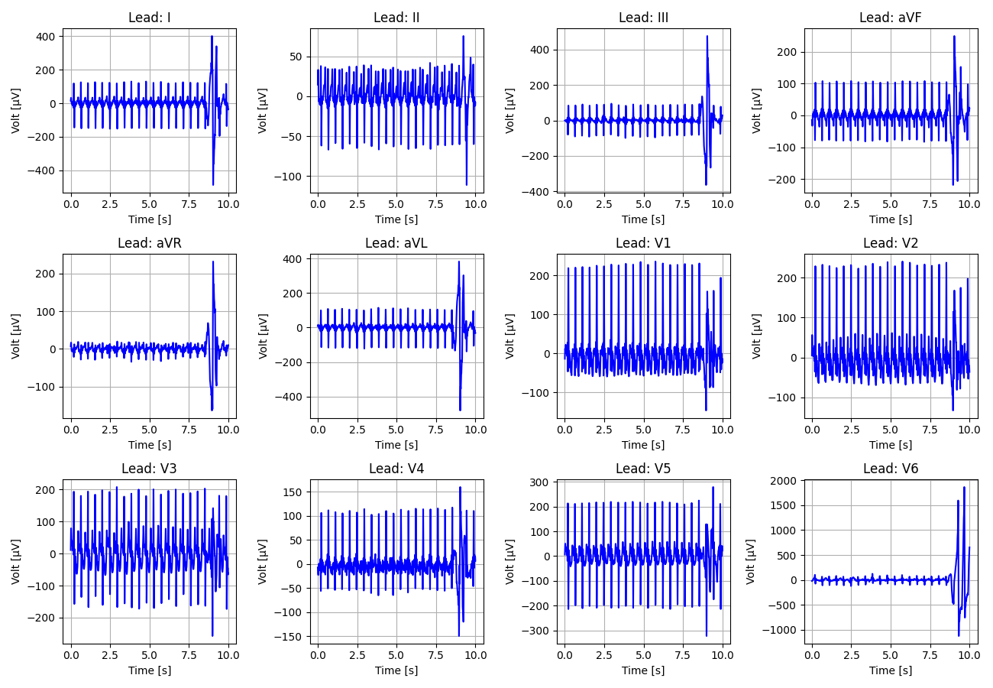
67_Recording_2993457

Slide 68

68_Recording_1463775

Slide 69

69_Recording_2378950

Slide 70

70_Recording_1730951

Slide 71

71_Recording_2246806

Slide 72
72_Recording_2471471

Slide 73
73_Recording_2331194

Slide 74
74_Recording_2212042

Slide 75

75_Recording_2846714

Slide 76

76_Recording_1435087

Slide 77

77_Recording_1789020

Slide 78

78_Recording_2745435

Slide 79
79_Recording_2535792

Slide 80

80_Recording_1556297

Slide 81

81_Recording_1337378

Slide 82

82_Recording_1003574

Slide 83

83_Recording_2547535

Slide 84

84_Recording_1301273

Slide 85

85_Recording_1968052

Slide 86

86_Recording_1897448

Slide 87

87_Recording_2685031

Slide 88

88_Recording_1532215

Slide 89

89_Recording_1139166

Slide 90
90_Recording_2761488

Slide 91

91_Recording_1948708

Slide 92

92_Recording_1707186

Slide 93
93_Recording_2984959

Slide 94

94_Recording_2834677

Slide 95

95_Recording_1377539

Slide 96
96_Recording_2776731

Slide 97
97_Recording_2352525

Slide 98

98_Recording_2990643

Slide 99
99_Recording_2298270

Slide 100

100_Recording_1279102

Slide 101

101_Recording_1756508

Slide 102

102_Recording_2271306

Slide 103
103_Recording_1038105

Slide 104

104_Recording_1703846

Slide 105

105_Recording_1708868

Slide 106

106_Recording_1781728

Slide 107

107_Recording_2294899

Slide 108

108_Recording_2530638

Slide 109
109_Recording_1301328

Slide 110

110_Recording_1355055

Slide 111

111_Recording_1327085

Slide 112

112_Recording_1403997

Slide 113
113_Recording_1002603

Slide 114

114_Recording_1628173

Slide 115

115_Recording_2518132

Slide 116

116_Recording_1347106

Slide 117

117_Recording_1648581

Slide 118

118_Recording_1063069

Slide 119

119_Recording_2342679

Slide 120

120_Recording_2815290

Slide 121

121_Recording_2213956

Slide 122

122_Recording_1408675

Slide 123

123_Recording_1202296

Slide 124
124_Recording_2230467

Slide 125

125_Recording_1454865

Slide 126

126_Recording_2941243

Slide 127

127_Recording_1101829

Slide 128
128_Recording_2608391

Slide 129

129_Recording_1951446

Slide 130

130_Recording_1670989

Slide 131

131_Recording_2386741

Slide 132

132_Recording_2063503

Slide 133
133_Recording_2152580

Slide 134
134_Recording_2432060

Slide 135

135_Recording_2085388

Slide 136

136_Recording_2734941

Slide 137
137_Recording_1327659

Slide 138

138_Recording_1531776

Slide 139

139_Recording_2280128

Slide 140

140_Recording_1480991

Slide 141

141_Recording_2373003

Slide 142

142_Recording_1164815

Slide 143

143_Recording_2814777

Slide 144

144_Recording_1700006

Slide 145

145_Recording_1105115

Slide 146

146_Recording_2402945

Slide 147

147_Recording_1034914

Slide 148

148_Recording_1050325

Slide 149

149_Recording_2749655

Slide 150

150_Recording_1344978

Slide 151
151_Recording_1076589

Slide 152

152_Recording_2945144

Slide 153

153_Recording_1791997

Slide 154
154_Recording_2307927

Slide 155

155_Recording_1474710

Slide 156
156_Recording_1255536

Slide 157

157_Recording_1006637

Slide 158

158_Recording_1243537

Slide 159

159_Recording_1436962

Slide 160

160_Recording_1086219

Slide 161

161_Recording_1902736

Slide 162

162_Recording_1691516

Slide 163

163_Recording_2722184

Slide 164

164_Recording_1156063

Slide 165
165_Recording_1772249

Slide 166
166_Recording_1882255

Slide 167

167_Recording_1183223

Slide 168

168_Recording_1220041

Slide 169
169_Recording_1815563

Slide 170
170_Recording_2233440

Slide 171

171_Recording_1354265

Slide 172

172_Recording_2607058

Slide 173

173_Recording_1942060

Slide 174

174_Recording_1421230

Slide 175

175_Recording_2526844

